Slide 1
Integrated science for the co-creation of
global change adaptation pathways:
Ria de Aveiro lagoon region, Portugal
Peter Roebeling, Filomena Martins, Carlos Coelho & Paulo Silva
CESAM/GOVCOPP & Department of Environment and Planning
CERIS & Department of Civil Engineering
CESAM & Department of Physics
University of Aveiro, Portugal

Slide 2
Outline
Global change challenges
Ria de Aveiro lagoon region
Adaptation measures
Co-creation pathways
Conclusions

Slide 3
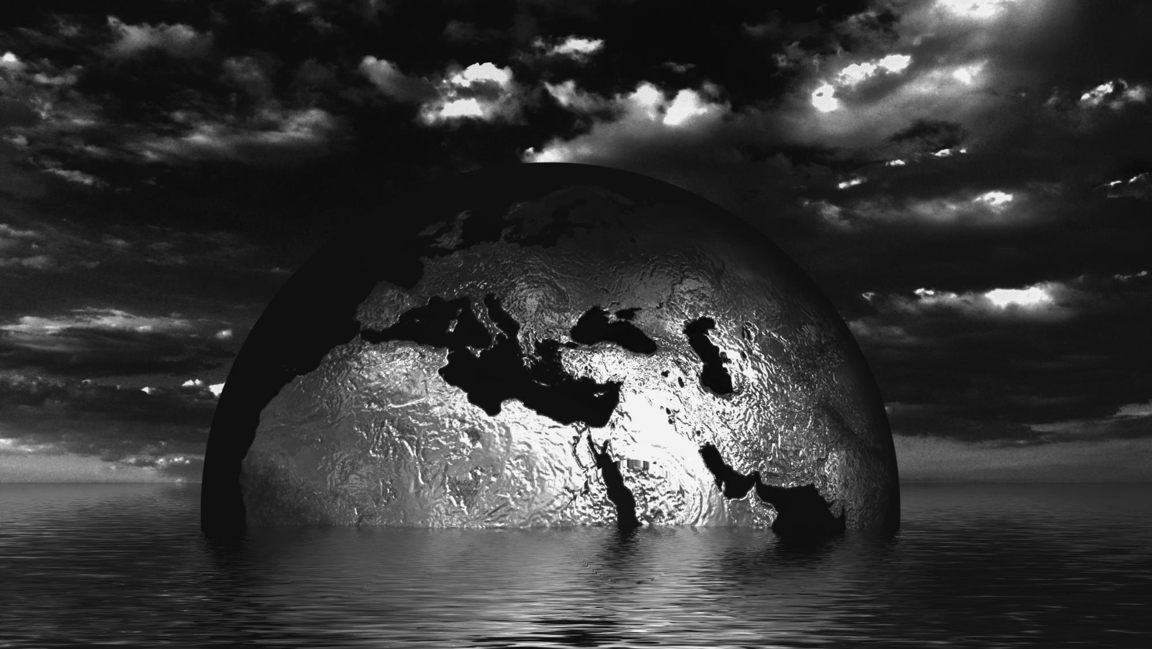
Climate
change
Population
growth
Geo-political shifts
Economic
development
Global change

Slide 4
Global change challenges in coastal areas
Implications:
  Rising sea levels
  Extreme rainfall events
  Increased storm surge frequencies
  Reduced sediment delivery to the coast
  Anthropoghenic transformations of natural coastal areas
Consequences for:
  Built capital: settlements, ports and infrastructure
  Natural capital: terrestrial, coastal and aquatic ecosystems
  Human, social & cultural capital: people, knowledge, communities, tourism and heritage

Slide 5
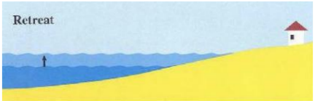
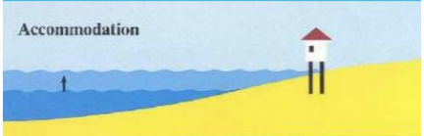
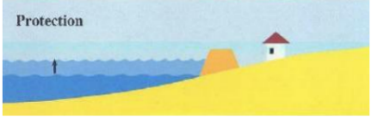
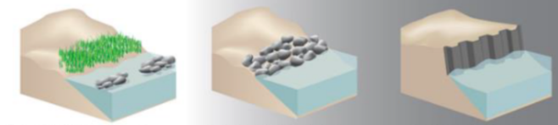
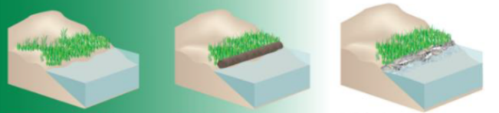
Global change challenges in coastal areas
Responses:
  Retreat: accept natural processes and re-locate
  Accommodate: accept natural processes and live with them
  Protect: don’t accept natural process and (try to) stop them
  Hard-gray measures
  Nature-based measures:
    Provide multiple ecosystem functions, services and values
    Provide direct benefits and multiple co-benefits
    Adapt to changing environmental conditions
  ← - - - - - - - - - - - - - - → Nature-based measures

Slide 6
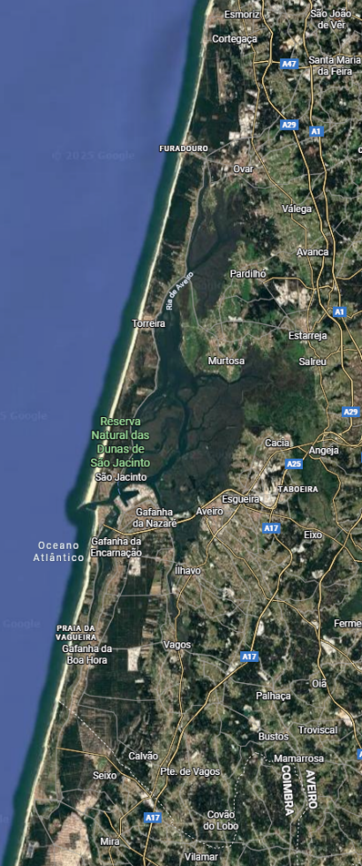
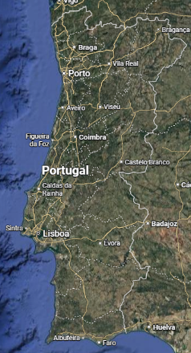
Ria de Aveiro lagoon region
Characteristics:
  Area 50 km (N-S) by 15 km (E-W)
  Shallow coastal lagoon and Natura 2000 area (wetlands, saltpans, …)
  Five rivers flowing into lagoon (Vouga, Antuã, Boco, Caster, Mira)
  One single inlet from Atlantic Ocean (port entrance Barra)
  Protected by sandy coastal dune system
  Strong morphodynamics
Aveiro

Slide 7
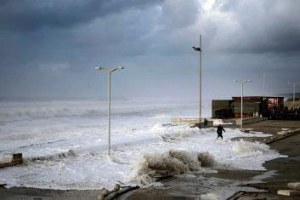
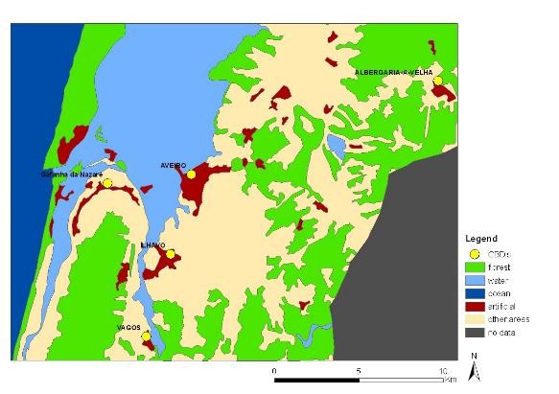
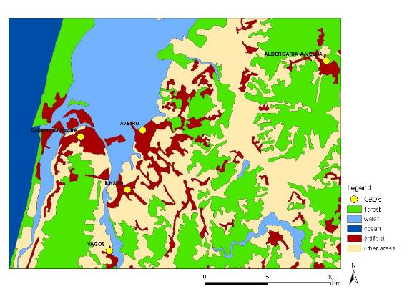
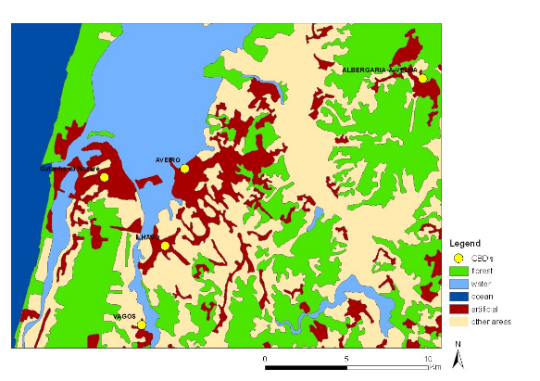
Ria de Aveiro lagoon region
Challenges:
  Coastal erosion
  Coastal flooding
  Fluvial flooding
  Urban residential expansion
  Industrial and port development
1975
1990
2006

Slide 8
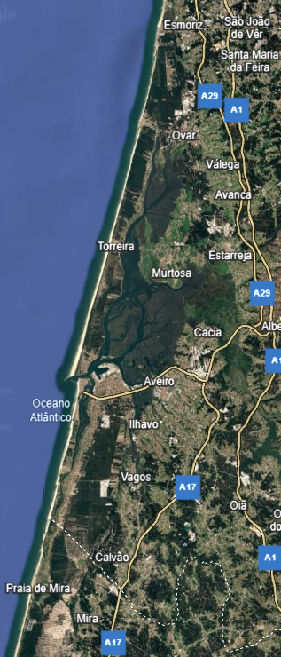
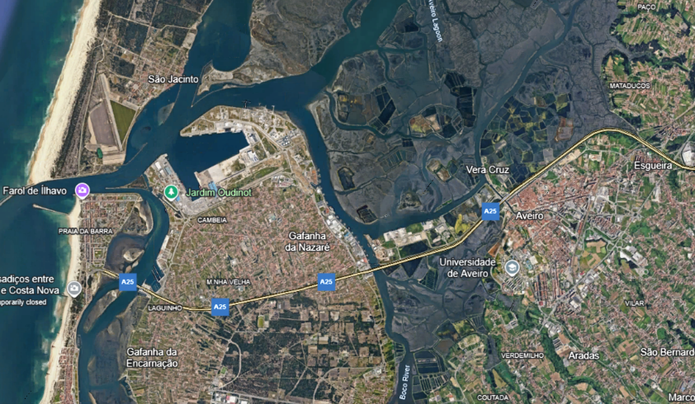
Adaptation measures
To date:
  Longitudinal: dikes
  Perpendicular: groins; breakwaters
  Beach nourishments
  Dune reinforcements
  Locks
  Green/blue spaces

Slide 9
Adaptation measures
To date:
  Longitudinal: dikes
  Perpendicular: groins; breakwaters
  Beach nourishments
  Dune reinforcements
  Locks
  Green/blue spaces
Envisaged:
  Locks
  Artificial reefs
  Wetland restoration
  Saltpan restoration

Slide 10

Co-creation pathways
Future vision
Current situation
Measures
Priorities

Slide 11
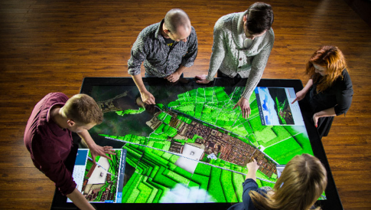
Co-creation pathways
Stakeholder engagement
  to identify issues, visions, values and solutions
  current and future
Informed decision-making
  based on best-available data, information and knowledge
  to assess multiple impacts, costs and benefits across time, space and stakeholders
Participatory planning
  to discuss multiple impacts, costs and benefits across time, space and stakeholders
  to facilitate creation of business models allowing for re-distribution of benefits
  to maximize societal benefits from adaptation

Slide 12
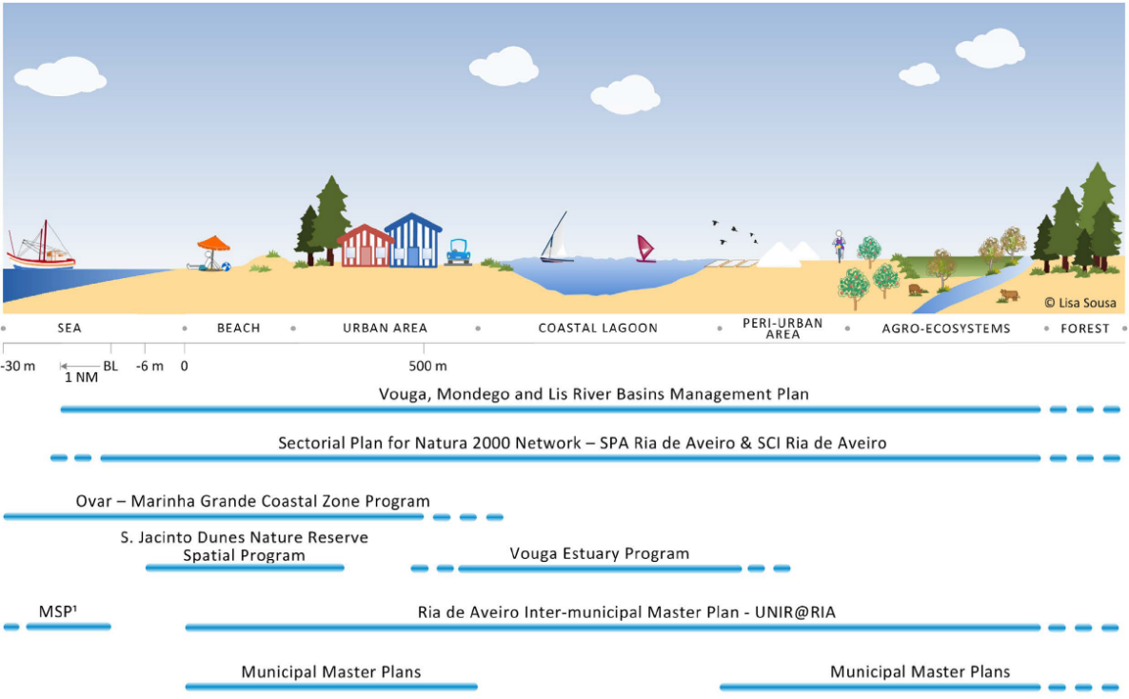
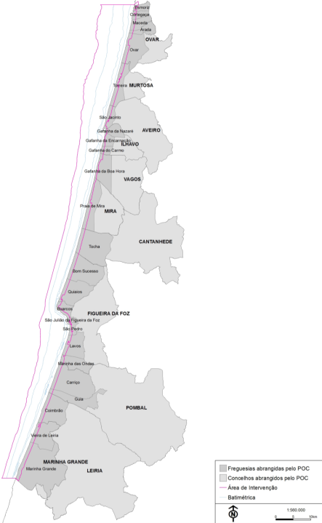
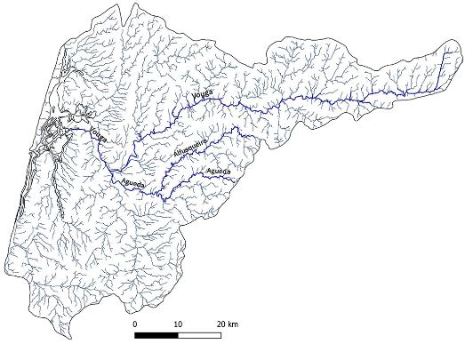
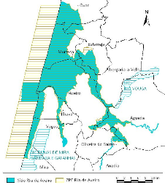
Co-creation pathways
Governance systems
  Coordination, integration, roles, responsibilities and financing
Sousa et al. (2016)

Slide 13
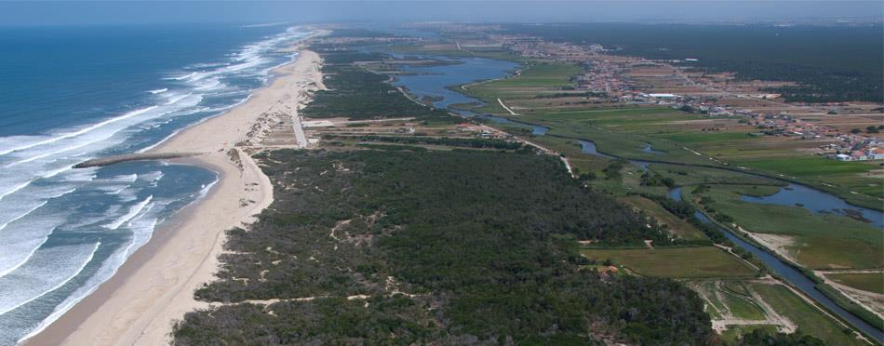
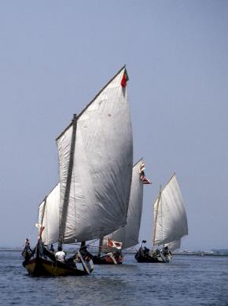
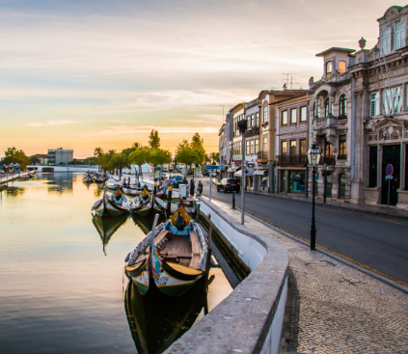
Conclusions
Ria de Aveiro lagoon region faces several challenges
Hard-gray and nature-based measures used and envisaged
Nature-based measures provide multiple functions, services and values
Adaptation pathways developed through co-creation
Based on informed and transparent decision-making
Through participatory planning process
Governance issues need to be explicitly addressed

Slide 14
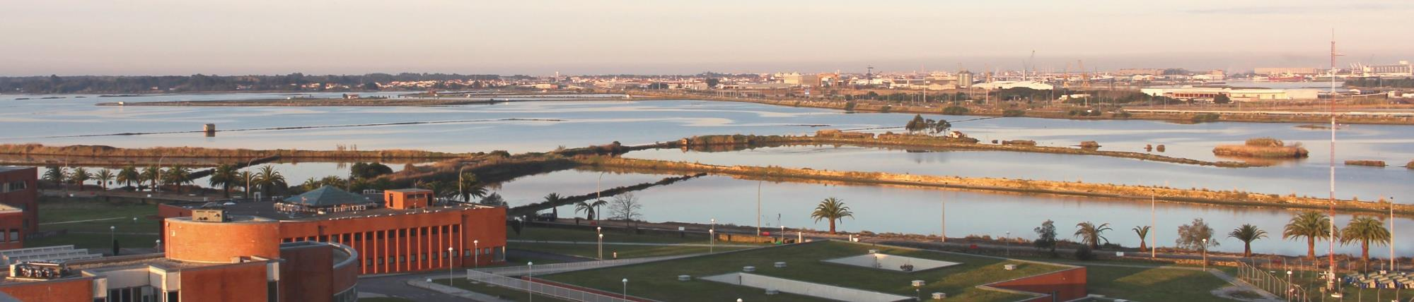
Dr. Peter C. Roebeling
Centro de Estudos do Ambiente e do Mar (CESAM)
Departamento de Ambiente e Ordenamento
Campus Universitário de Santiago
Universidade de Aveiro
3810-193 Aveiro
PORTUGAL
SCOPUS: https://www.scopus.com/authid/detail.uri?authorId=55984154700
ORCID: https://orcid.org/0000-0002-2421-9299
Tel.: +351 234 370 387
E-mail: peter.roebeling@ua.pt
Fax: +351 234 370 309
URL: https://www.cesam.ua.pt/roebeling

