Slide 1
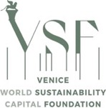
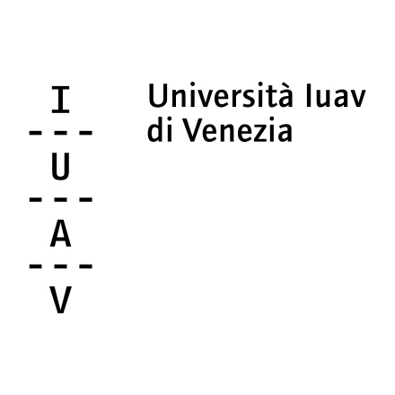
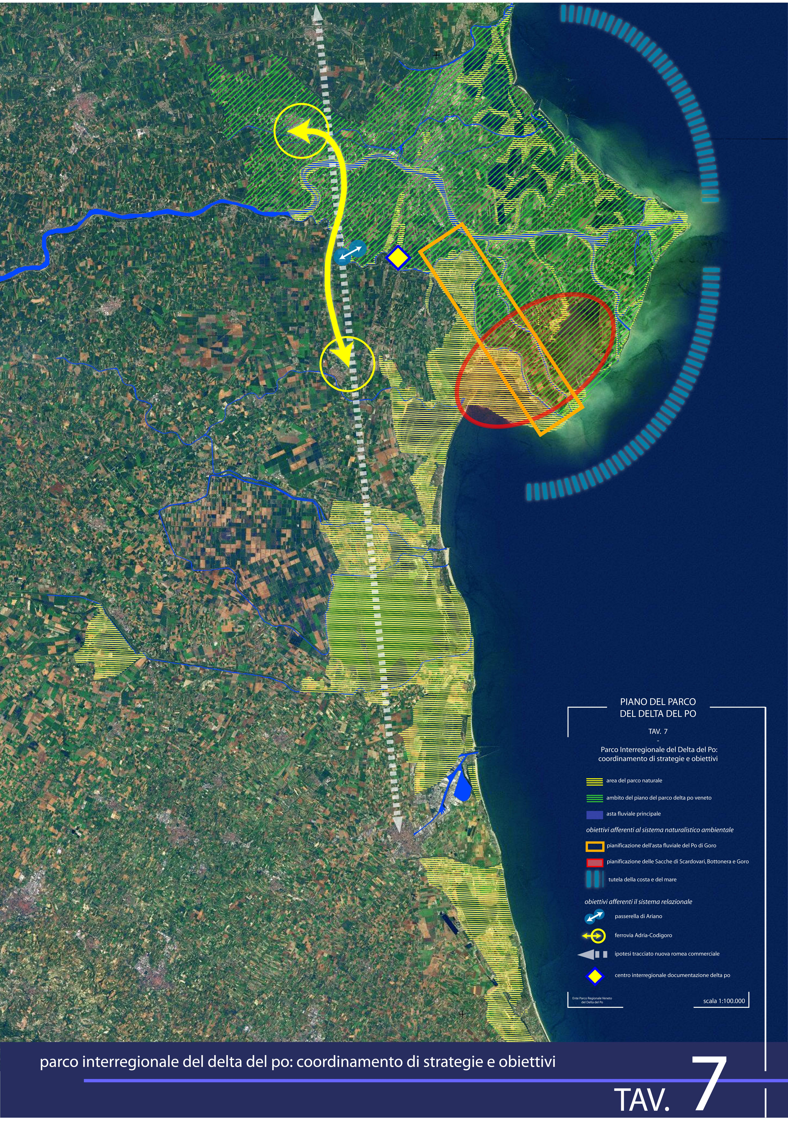
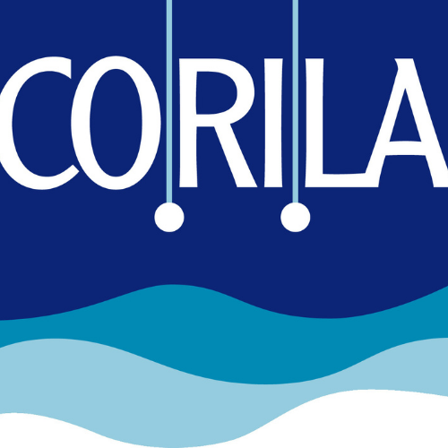
Coastal Cities, Climate Resilience and Cultural Heritage Preservation
17 November 2025
Teatro Piccolo Arsenale, Venezia
The role of spatial planning for coastal adaptation
Prof. Francesco Musco
Università Iuav di Venezia and Corila

Slide 2
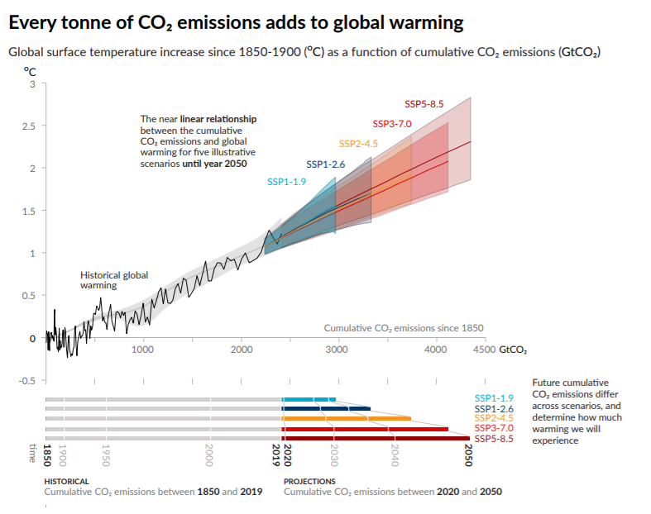
Spatial Planning for coastal system
Coastal cities are increasingly at the frontline of climate risk, due the global increase of climate externalities.
More than 600 million people currently live less than 10 metres above sea level, and this number could double by the end of the century
Sea-level rise is accelerating. Storm surges intensify. Sediment budgets collapse. Land subsides. These dynamics interact. And spatial planning is where they must be managed together.
.

Slide 3
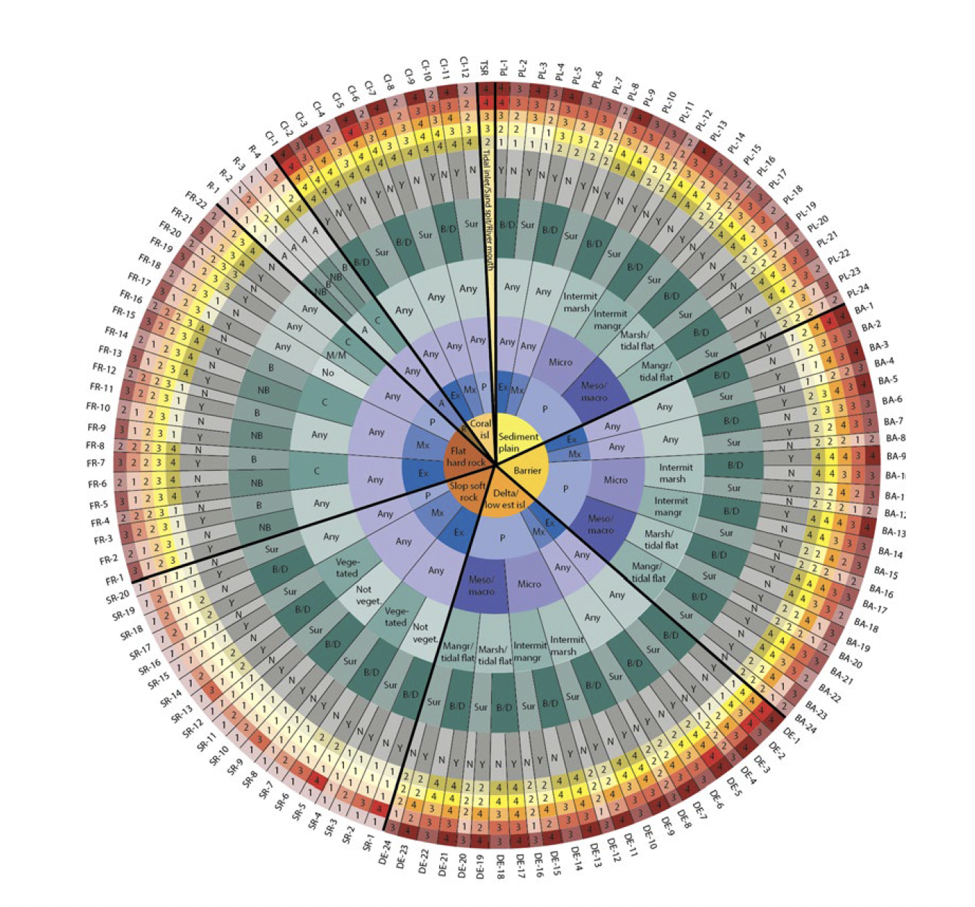
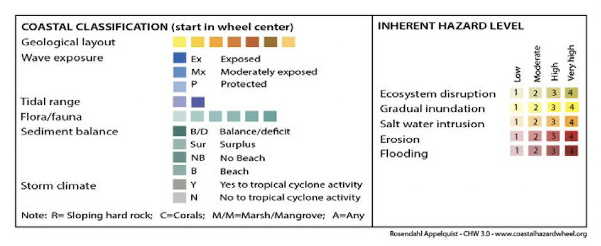
Spatial Planning for coastal system
United Nations Environment Programme (UNEP), Coastal Hazard Wheel. This tool provides an overview of the main hazards based on coastline types. Source: (Rosendahl Appelquist, Balstrøm, Halsnæs, 2016).

Slide 4
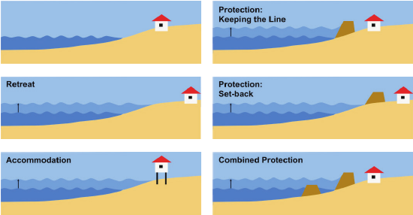
Adaptation strategies with planning outputs
IPCC adaptation strategies are measures and actions taken to reduce vulnerability to the impacts of climate change. These strategies can be categorized as infrastructural (e.g., building seawalls), institutional (e.g., creating new insurance schemes), behavioral (e.g., changing crop planting times), and nature-based-solutions (e.g., restoring forests). The goal is to manage both current climate impacts and prepare for future climate change scenarios

Slide 5
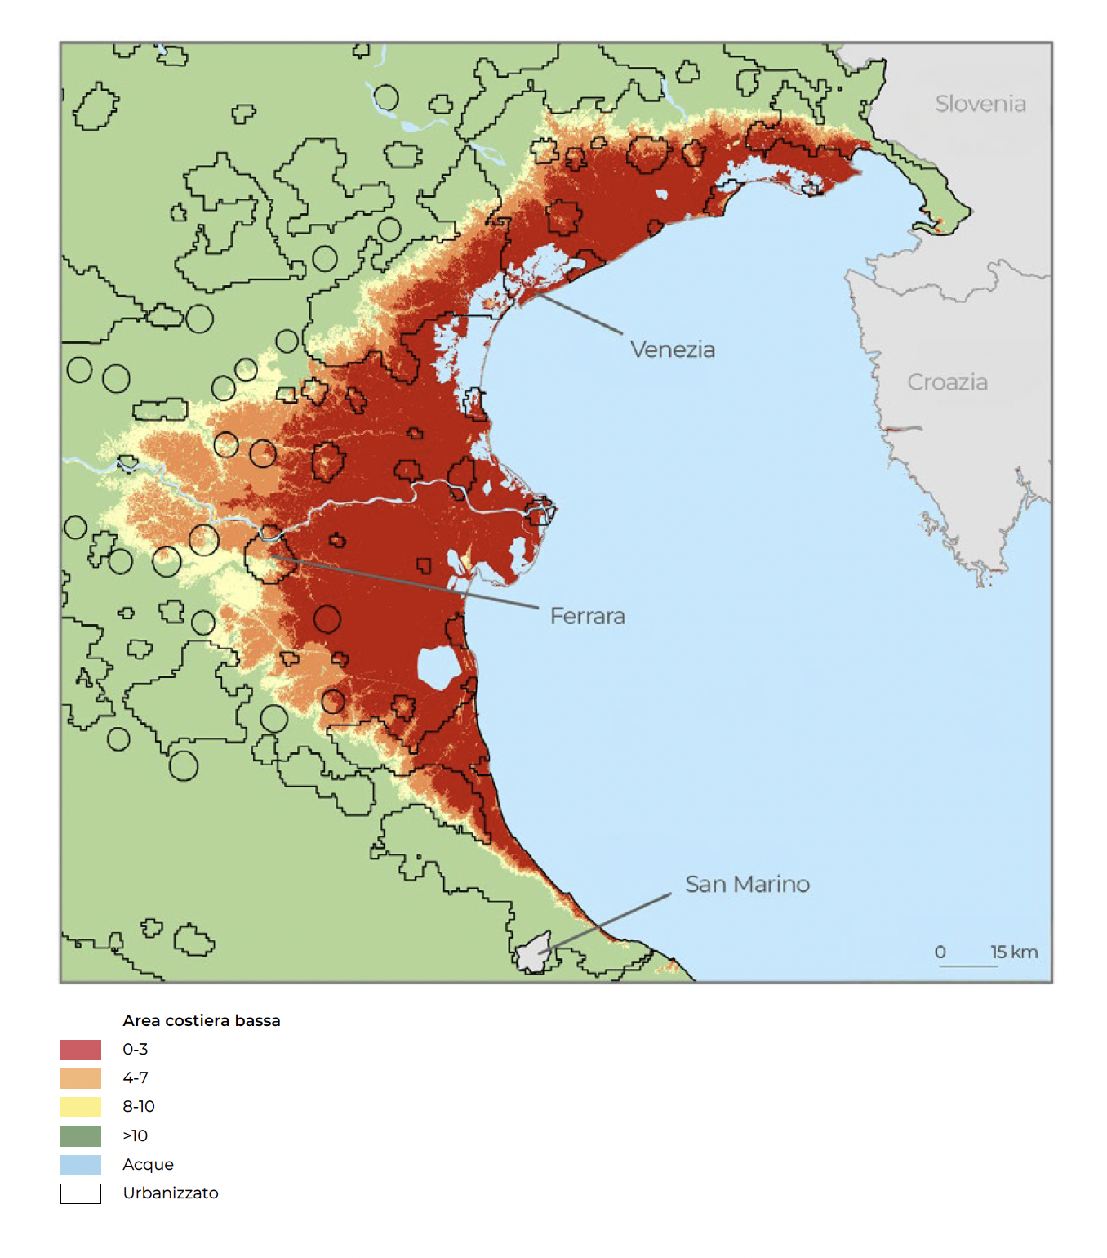
Spatial Planning for coastal system
Upper Adriatic. Low Elevation Coastal Zone (LECZ), identified on the basis of different continuous bands of elevation above sea level. Source: (Columbia University, Centre for International Earth Science Information Network, 2013).
.

Slide 6
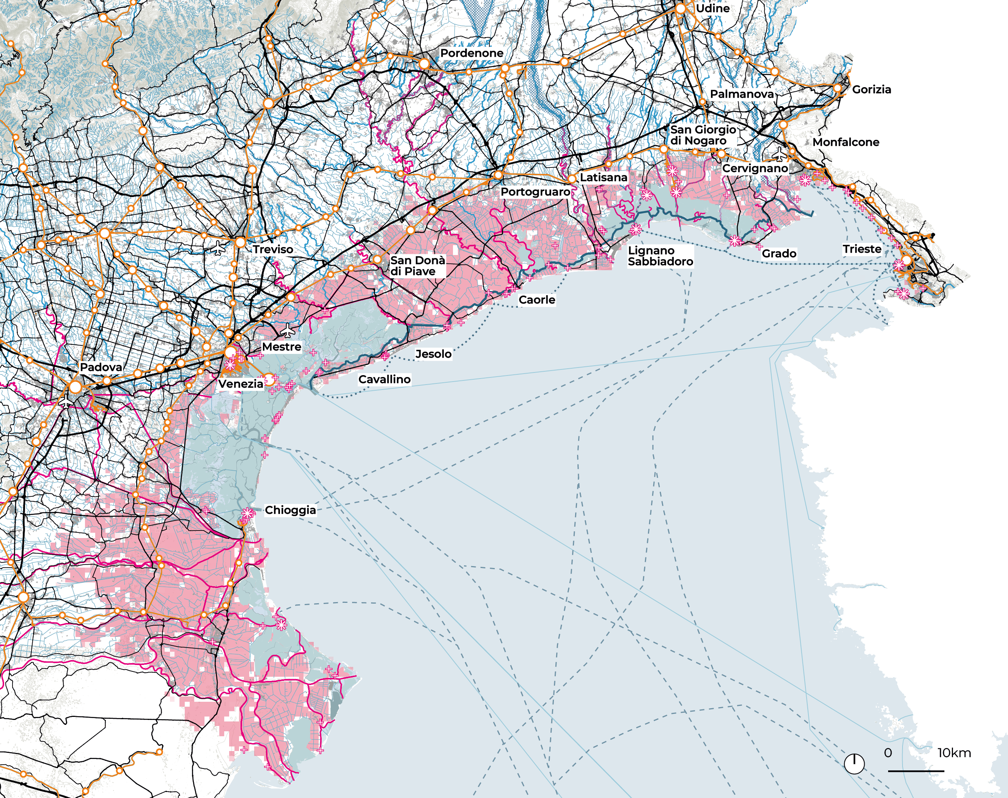

Regional (coastal) level: a wide buffer on coastal system:
areas between -5 and +1,4 on sea level.
Concentration of infrastructures, networks and urban areas along the coastal buffer/risk sea level rise
Northern Adriatic
Source iNEST Iuv-Units SP8, 2024
6

Slide 7
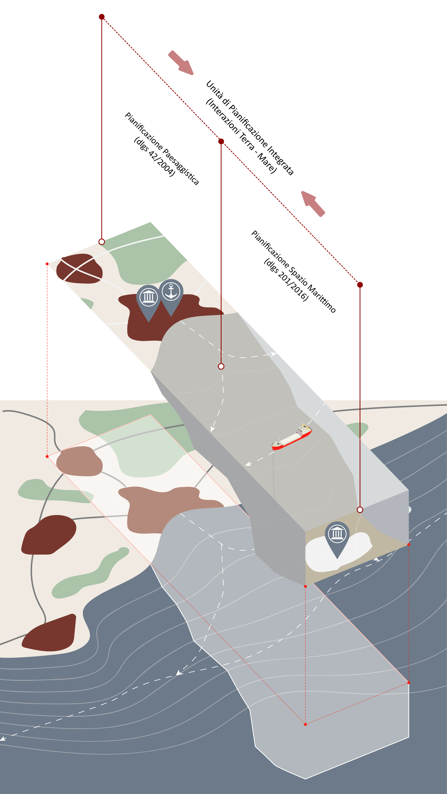
Land sea interactions
It is essential to establish a base knowledge on the Land–Sea Interactions discourse to support and manage the coastal and maritime spatial planning processes. Such an approach will contribute to dealing with the increasing pressure on both the sea and coastal areas by improving synergies and reducing conflicts. Moreover, the issue of climate change is inextricably linked with coastal zones and their own interactions.
The continuity of spatial planning is an asset for integration of spatial planning domain
.

Slide 8
Innocenti A. Musco F. (2023) Land Sea Interaction: A spatial planning perspective, Sustainability 15, 9446

Slide 9
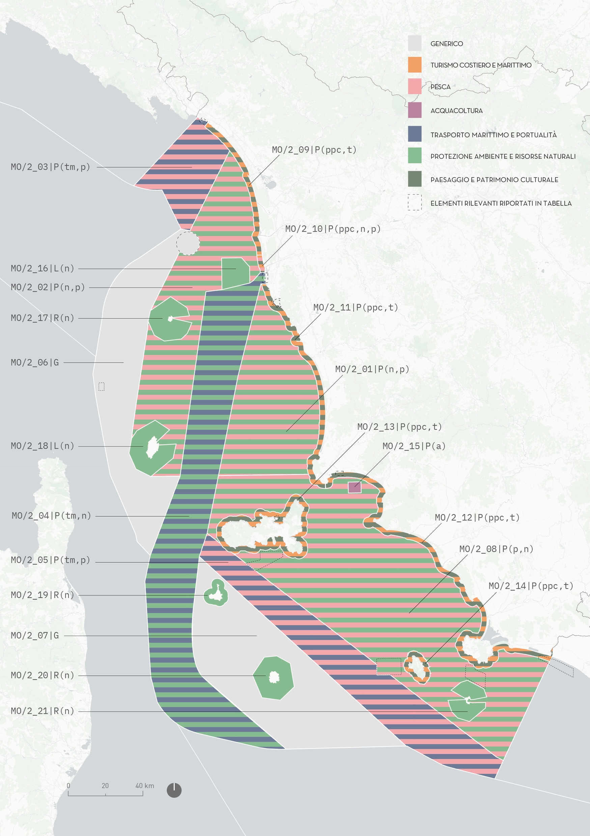
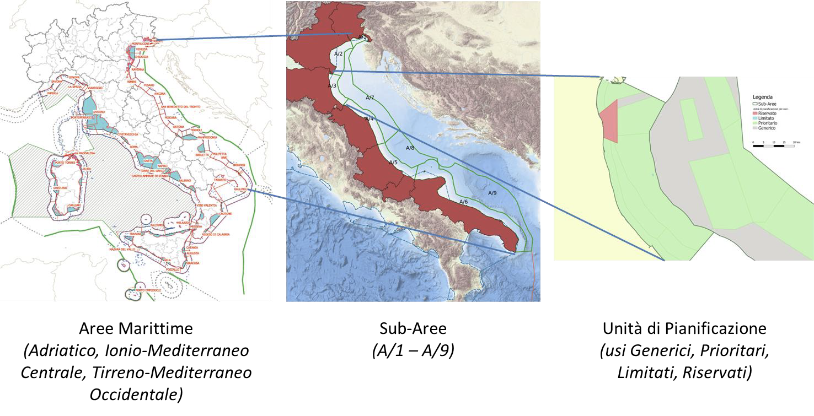
Maritime Spatial Planning
Maritime spatial planning as a tool to support continuity of spatial management between coast and maritime regions.
Source: Italian Maritime Spatial Plan, MIT, elaborations CNR-Iuav- Corila (2024)

Slide 10
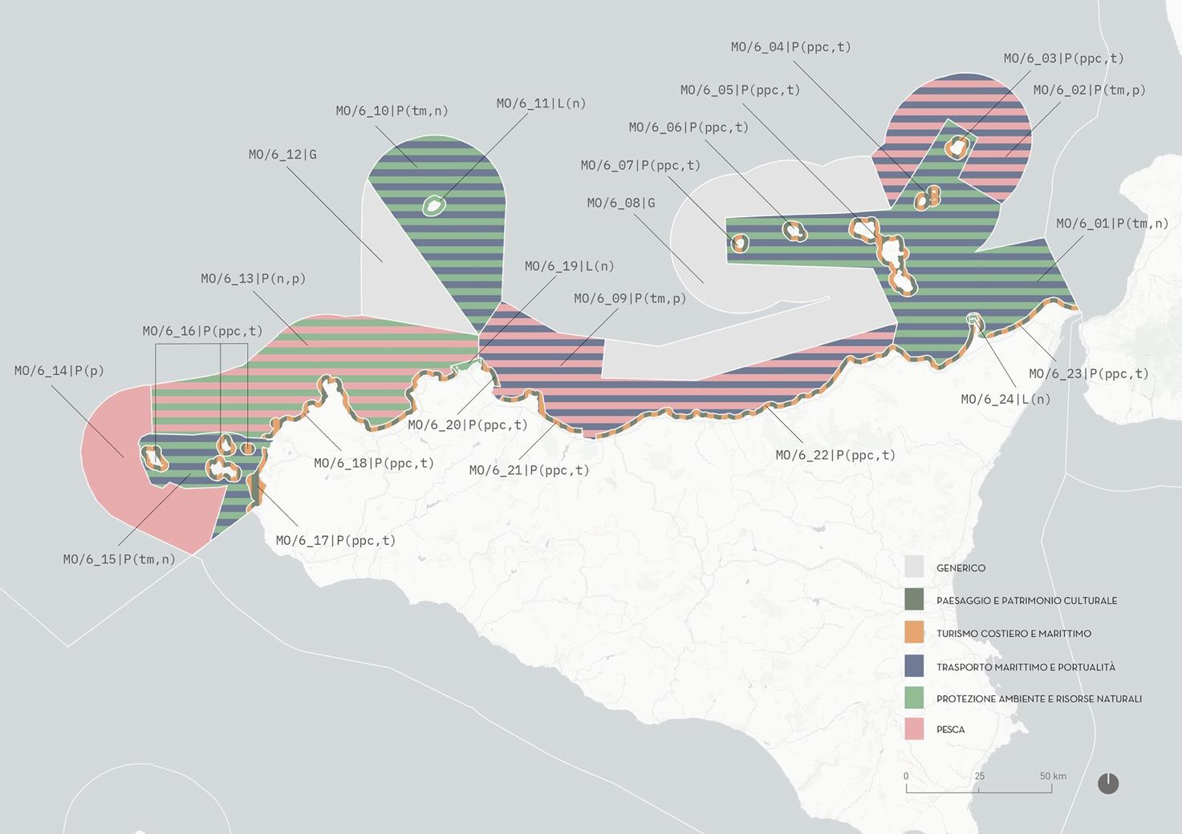
Maritime Spatial Planning
A proper management of the interphase, supporting a spatial continuity of planning measures between land and sea is one the aim of maritime spatial planning.
Source: Italian Maritime Spatial Plan, MIT, elaborations CNR-Iuav- Corila (2024)

Slide 11
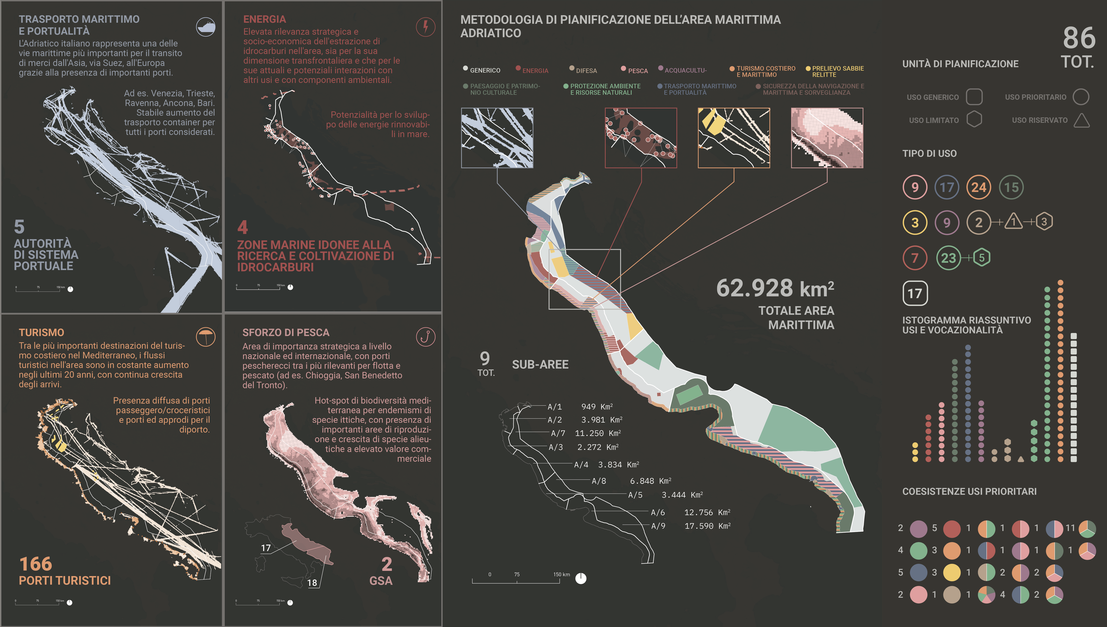

Slide 12
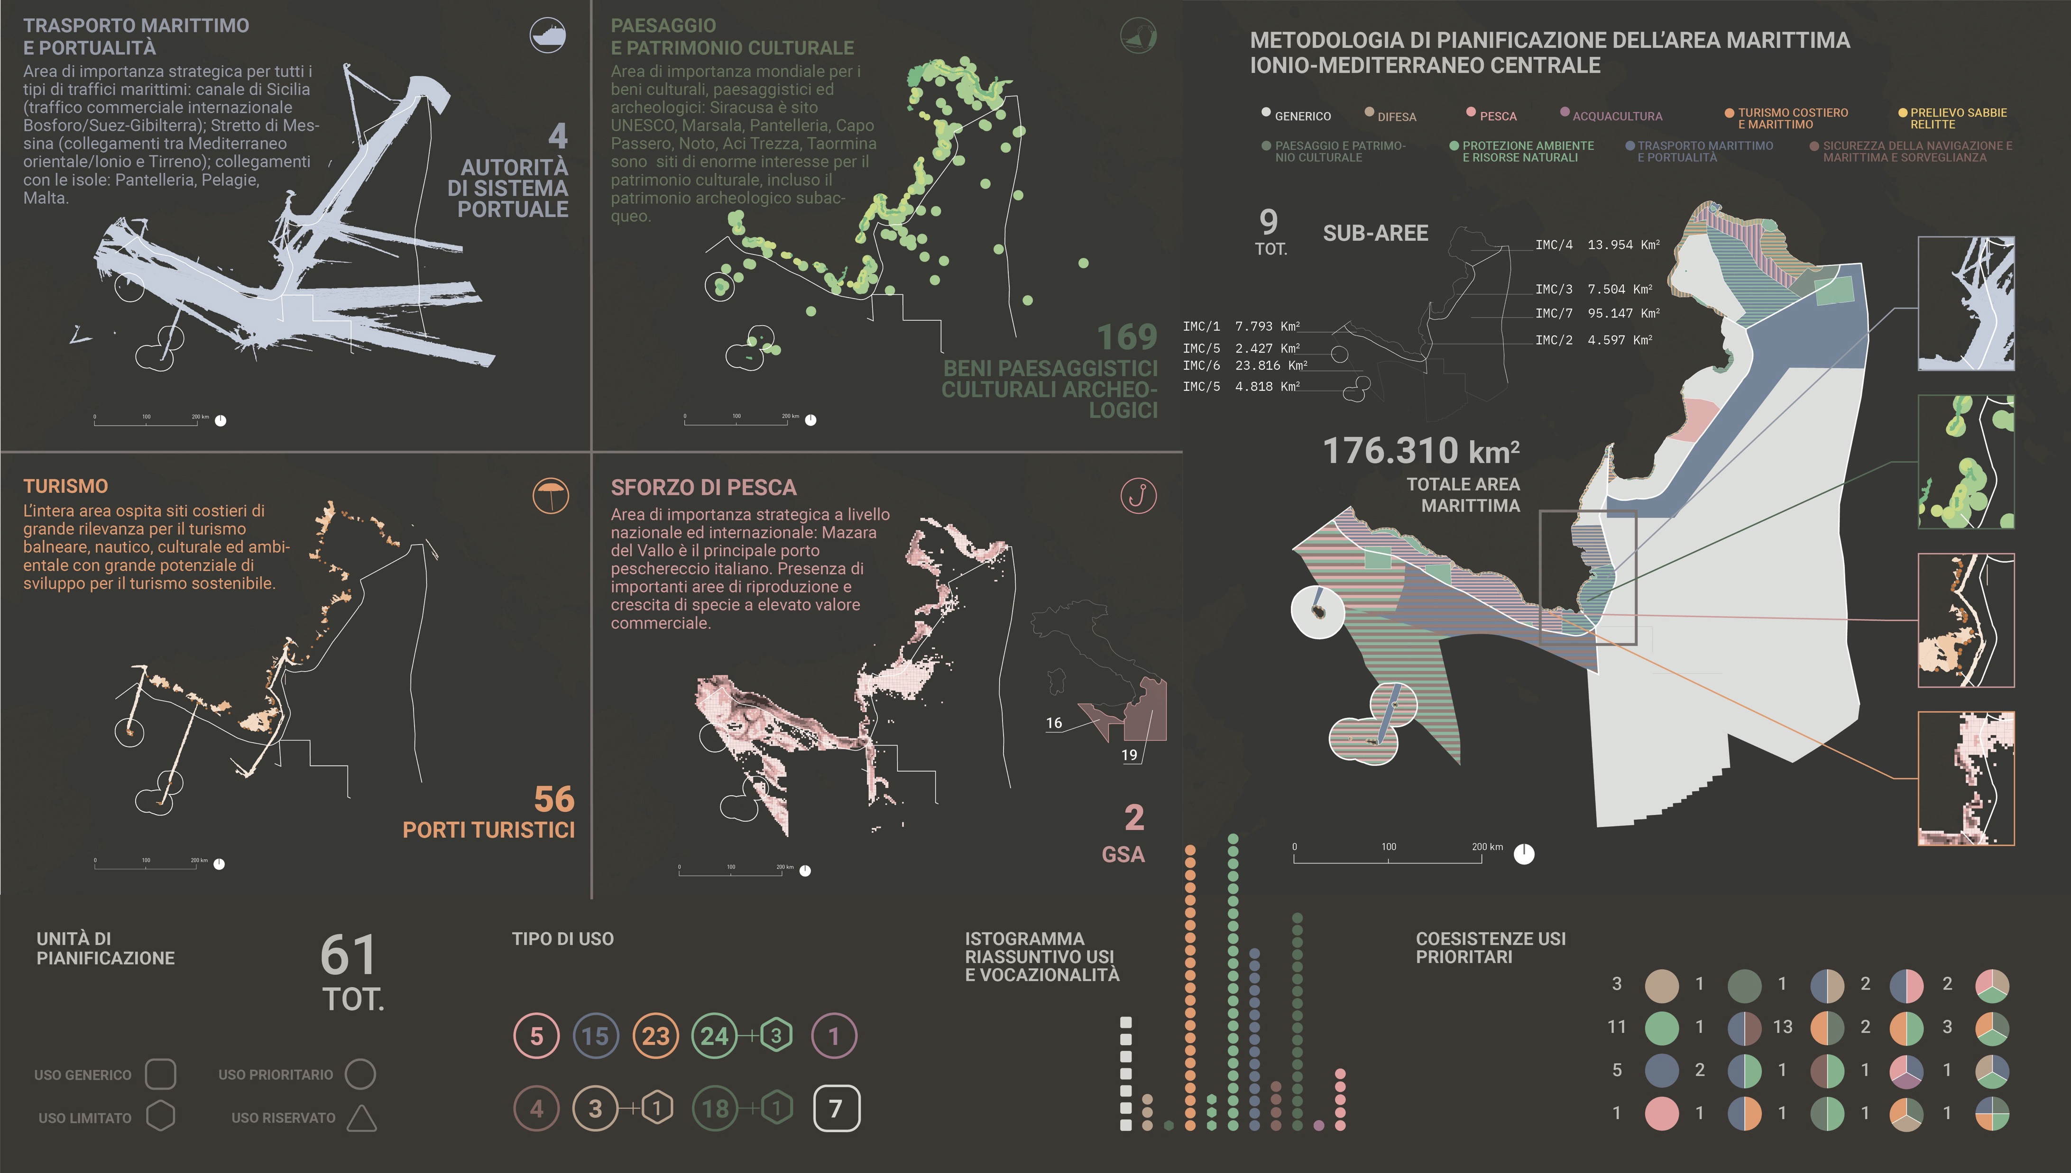

Slide 13
Delta Po
The Po Delta is not simply responding with emergency measures.
There are substantial planning tools in place:
• Po Delta Park management plan integrating biodiversity conservation with hydrological regulation.
• Municipal plans introducing setback zones and restrictions on building in erosion-prone coastal belts.
• Dune reconstruction using nature-based methods.
Source: Delta Po Park Environmental Plan (2011), elaboration Veneto Region and Iuav

Slide 14
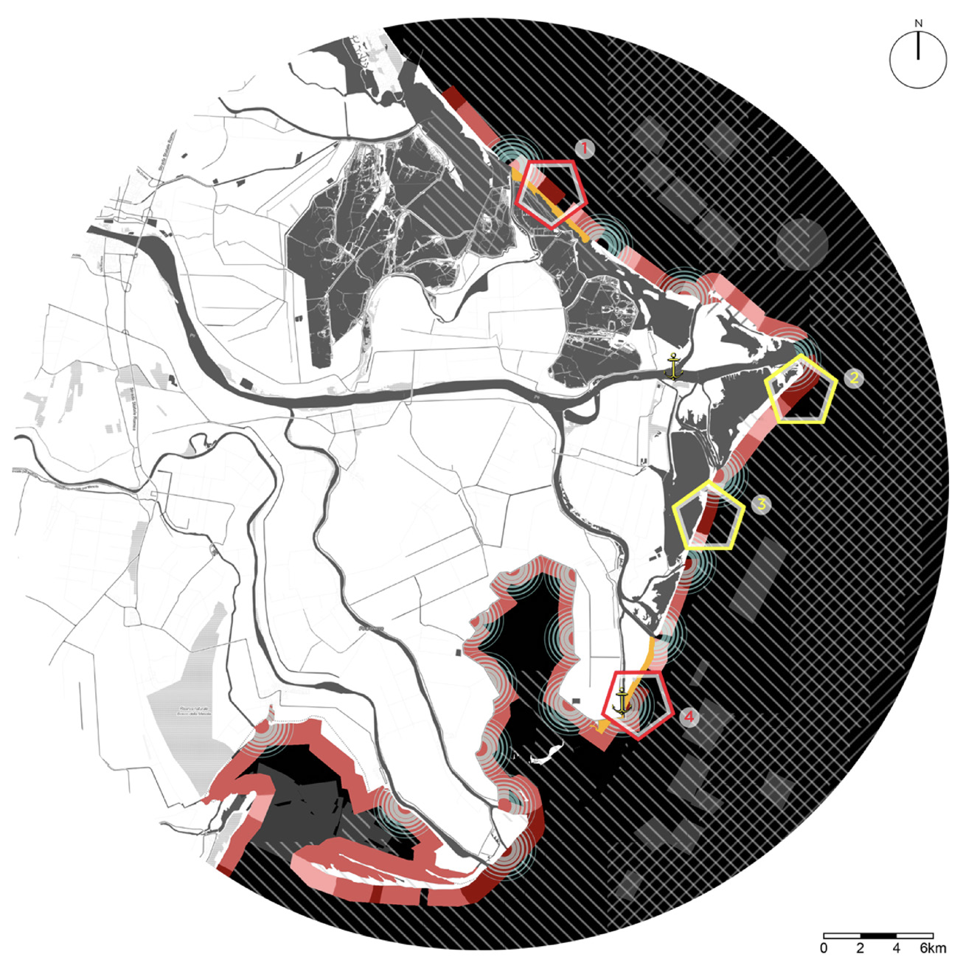
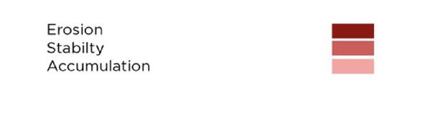
Delta Po
• Experiments in managed realignment, allowing selected areas to be intentionally flooded to relieve pressure on embankments.
• Wetland restoration projects in the Sacca di Goro and other lagoons.
(source Appiotti F. Magni F., Musco. F. (2023) Il Delta che cambia, Il Poligrafo)

Slide 15
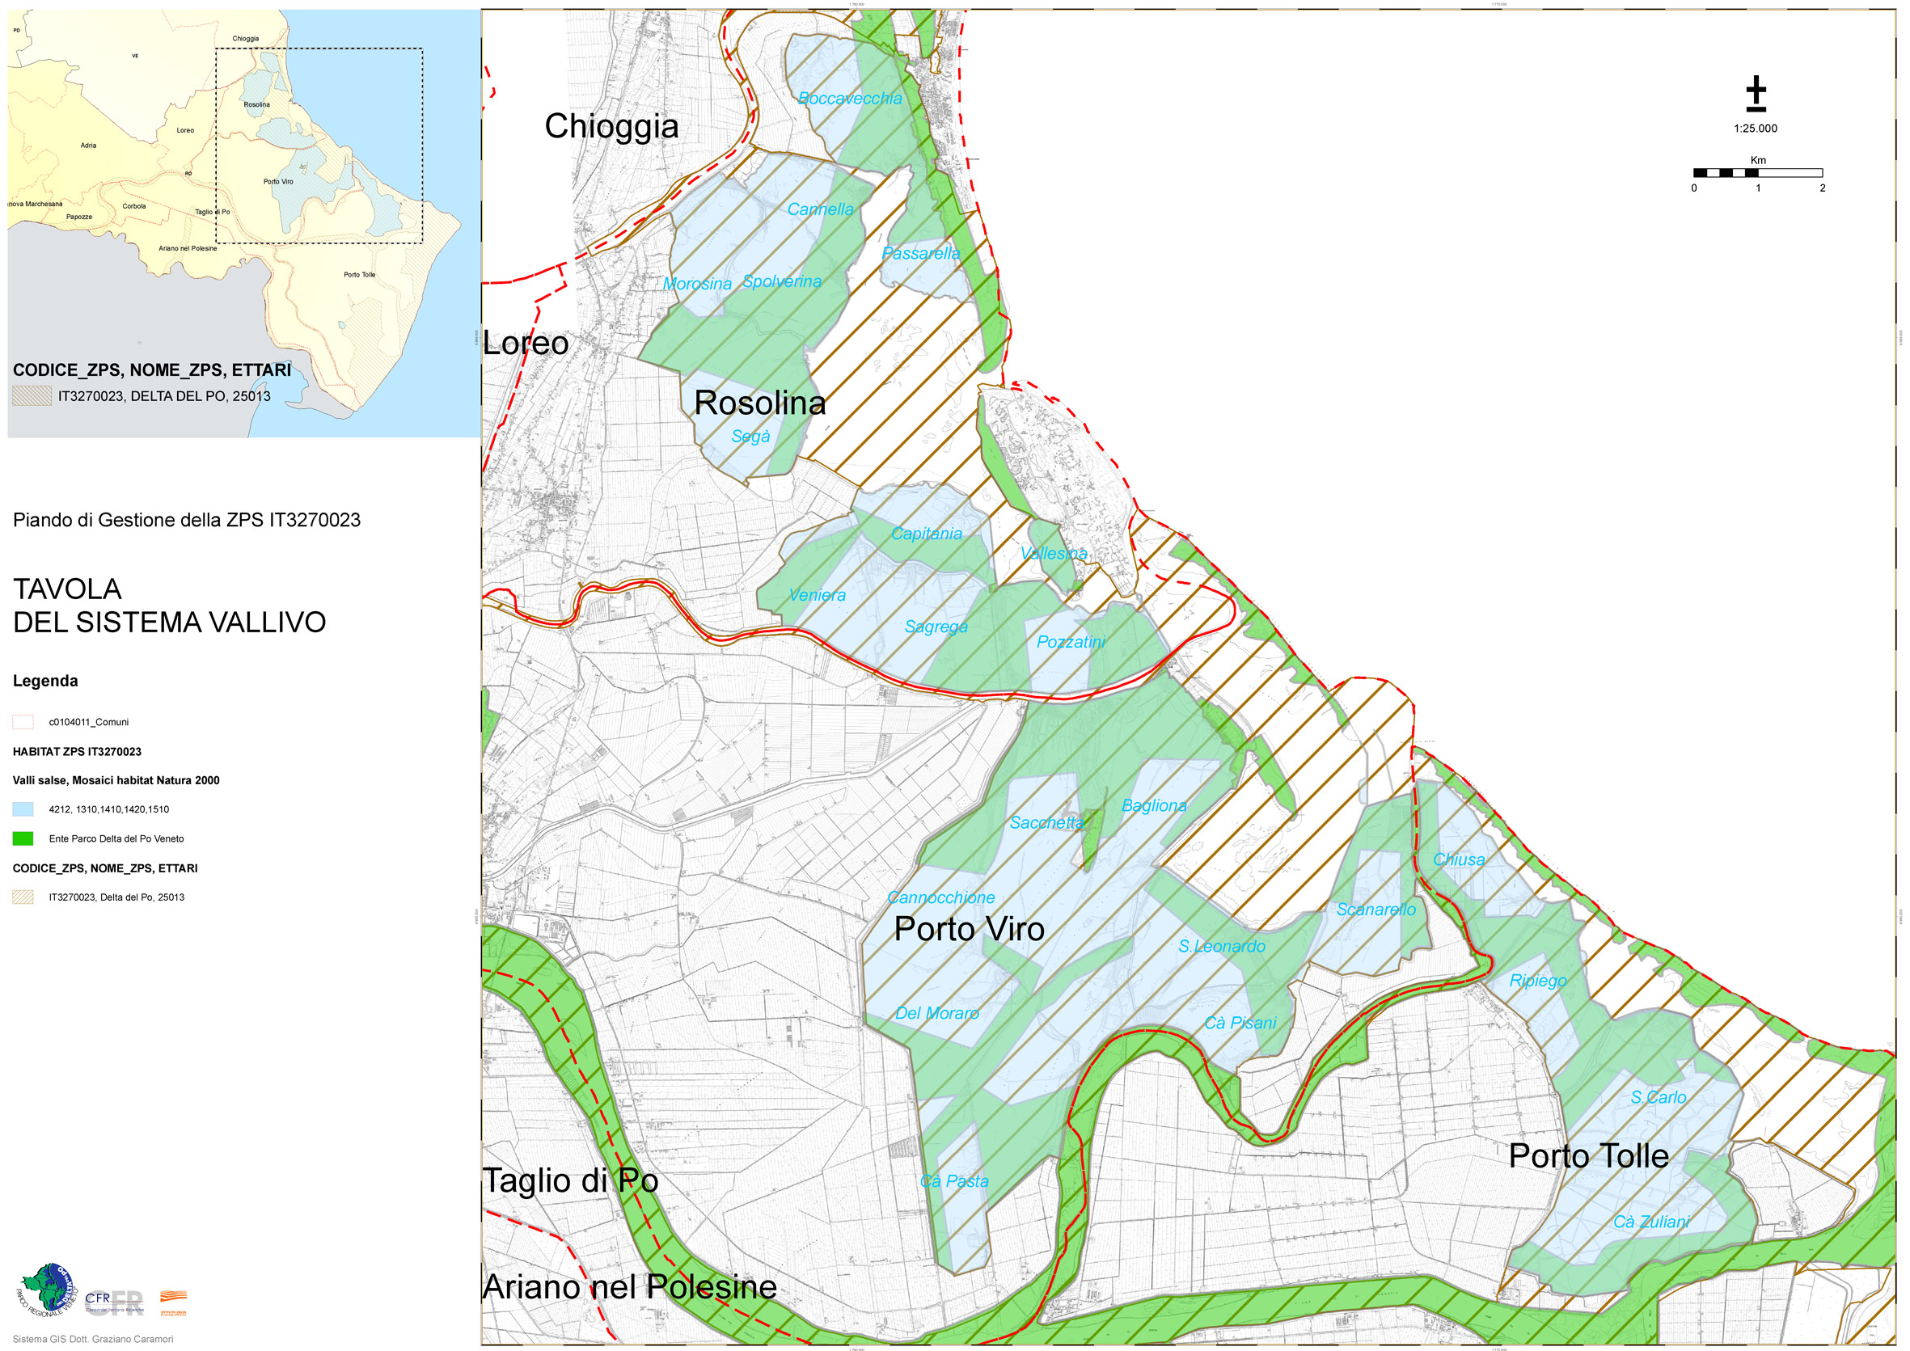
Delta Po
Integration of measure for interphase lagoons to properly maintain coastal system
Source: SPA Delta Po Plan Management Plan, Delta Po Park Authority-Iuav and Istituto Delta (2012)

Slide 16
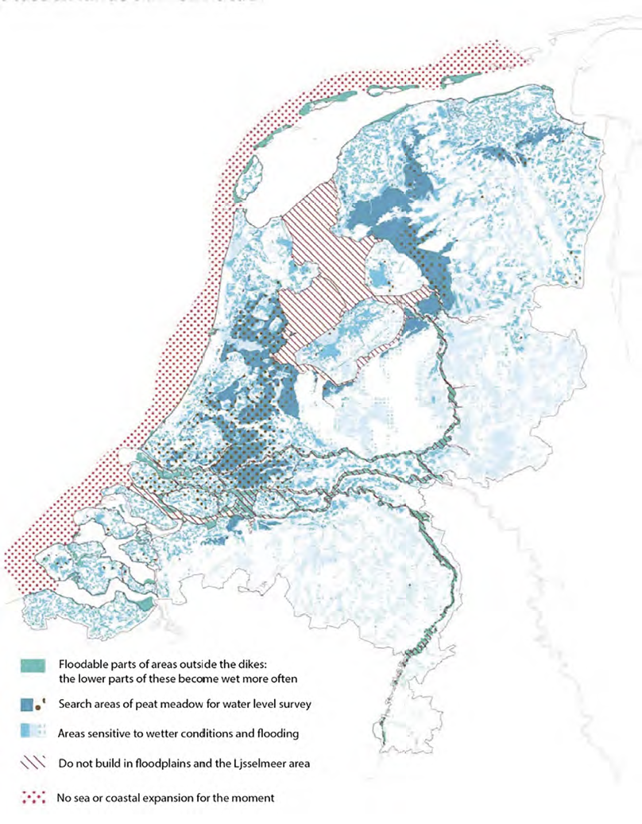
Rotterdam and Duch Delta
The Delta Programme 2024 and the new Nota Ruimte introduce key principles:
• No expansion of the coastline, to preserve sediment dynamics.
• Creation of river buffer zones for overflow and nature development.
• Use of adaptive pathways: planning decisions linked to thresholds such as +1 m, +2 m, +3 m of sea-level rise.

Slide 17
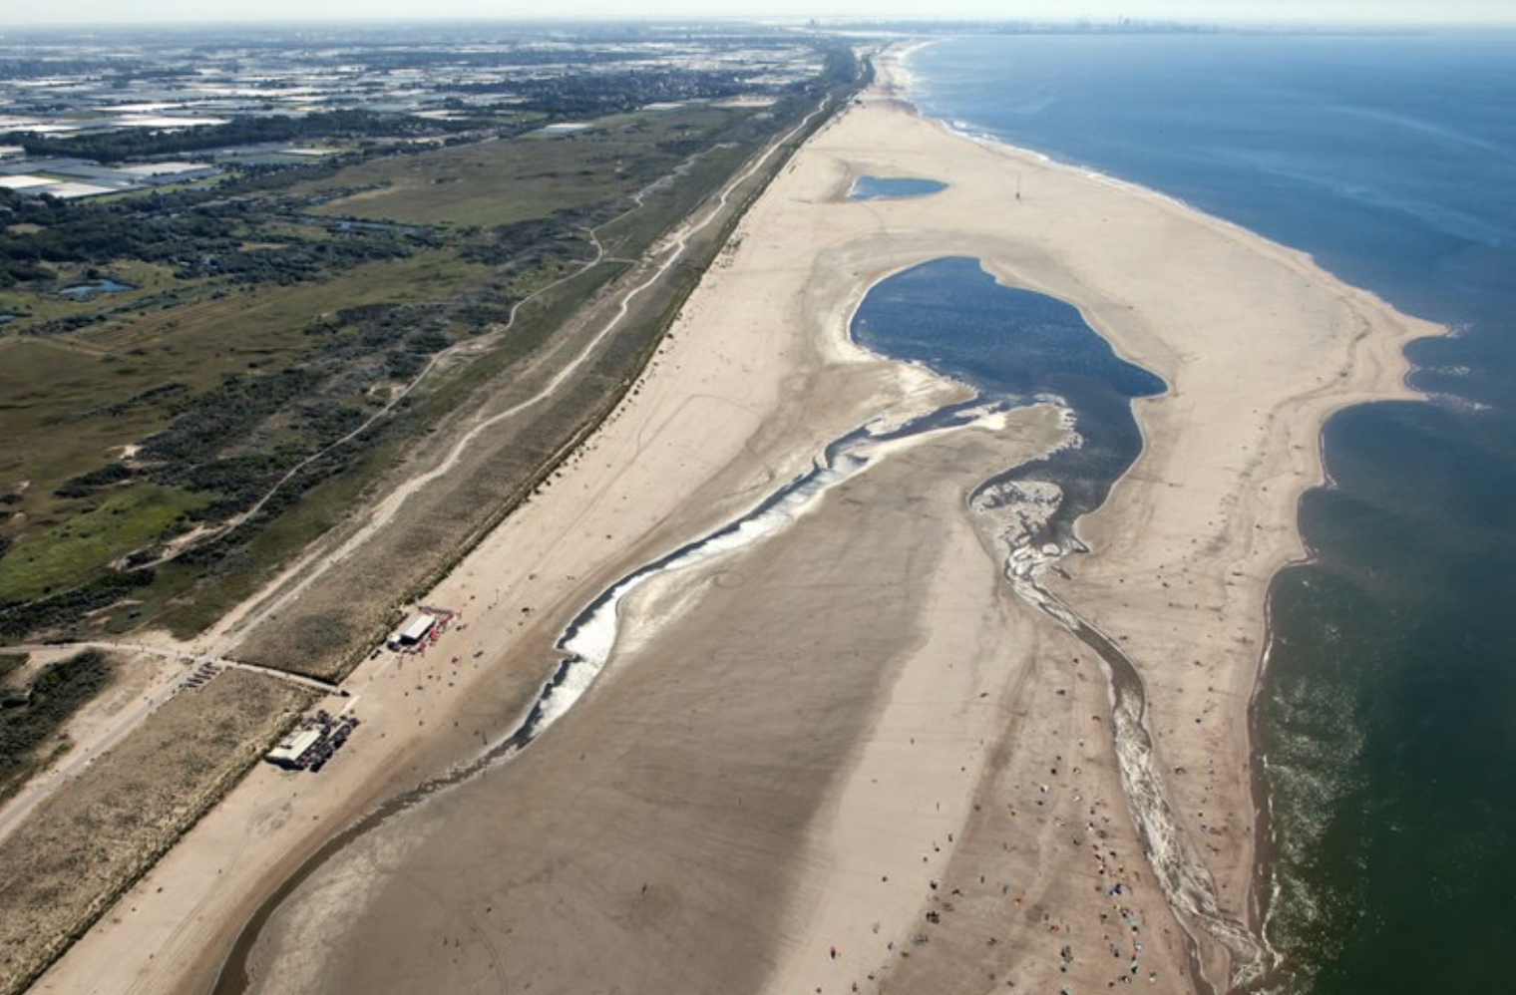
Rotterdam and Duch Delta
The Sand Motor, a Dutch mega-nourishment project implemented in 2011, formed a hook-shaped peninsula to protect the coastline, mitigate sea-level rise, and create recreational and ecological spaces.
Equivalent to 20 years of regular nourishment, it is achieving its goals of coastal preservation, habitat creation, and leisure opportunities.

Slide 18
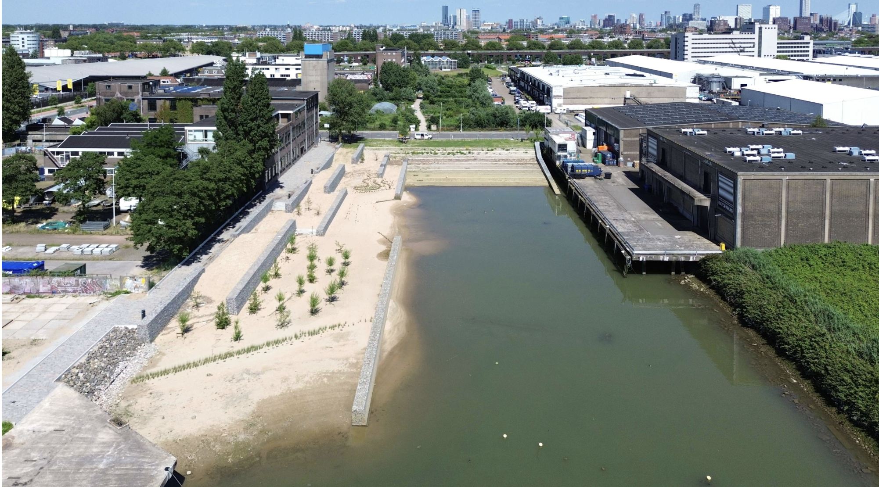
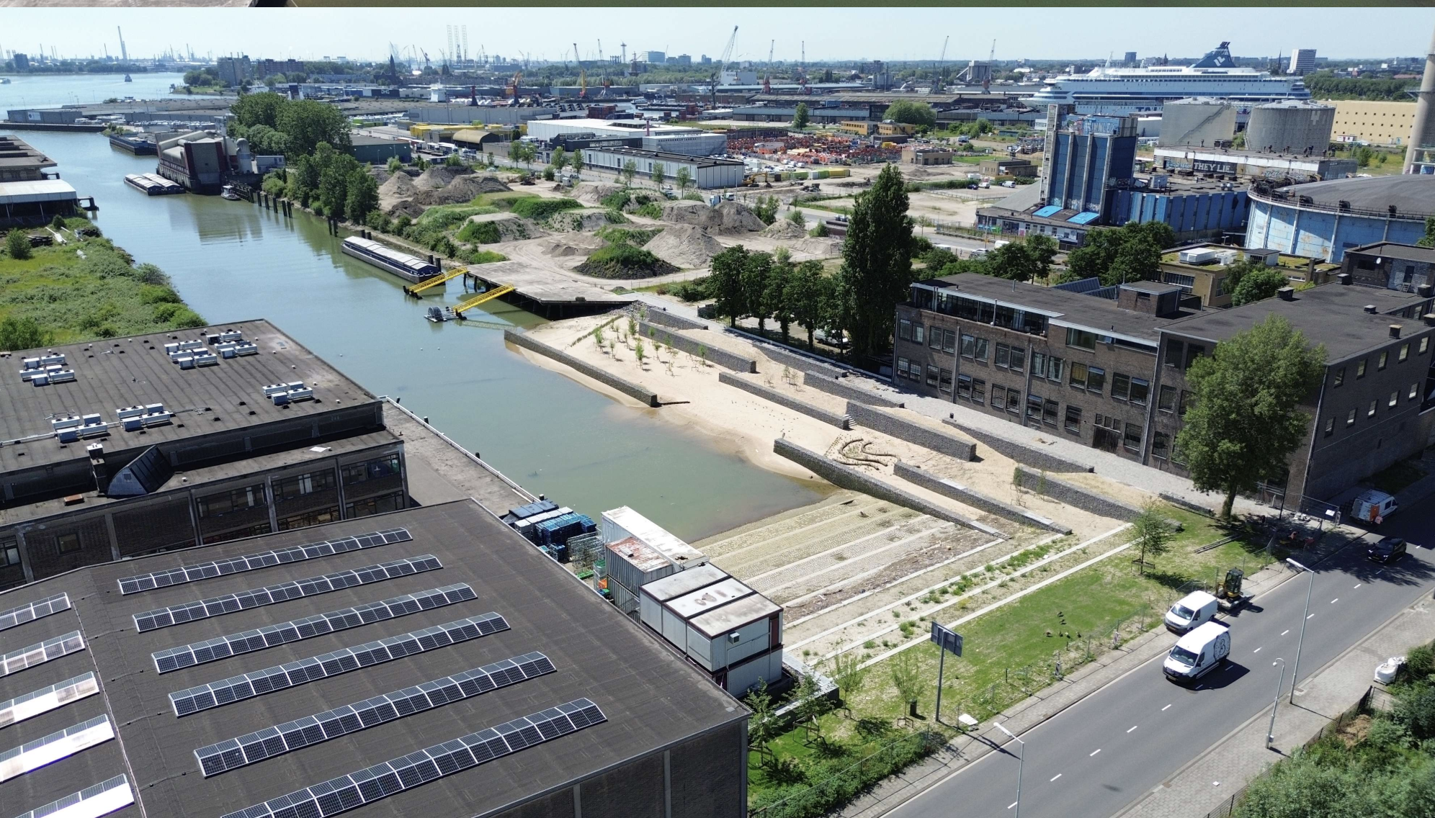
Rotterdam and Duch Delta
The Keilehaven Tidal Park in Rotterdam is a pioneering example of how sustainable urban development and rewilding can be combined.
The project combines the creation of a city park with the reintroduction of a natural estuarine system in an urban setting. This results in an innovative public space where the delta’s tidal landscape becomes visible and tangible.
floating neighbourhoods and offices,
adaptive public spaces,
temporary uses,
ecological infrastructures

Slide 19
Coastal adaptation is a spatial choice
How can we transform the challenge of sea-level rise into an opportunity to strengthen the bond between city and inhabitants? — is precisely the question spatial planning must address.
Sediment and space are the core adaptation resources.
Many coastlines lack both; thus governance of sediment transport becomes essential.
2. Coastal adaptation requires long-term spatial strategies, not short-term projects.
The Dutch example shows the importance of legally anchored long-term frameworks.
3. Retreat is politically difficult but increasingly necessary in selected locations.
The Po Delta experience demonstrates how retreat can be part of ecological enhancement.
4. Adaptation is not only technical — it is social, cultural, and political.
It requires communities to understand risks, accept transitions, and participate in decisions

Slide 20
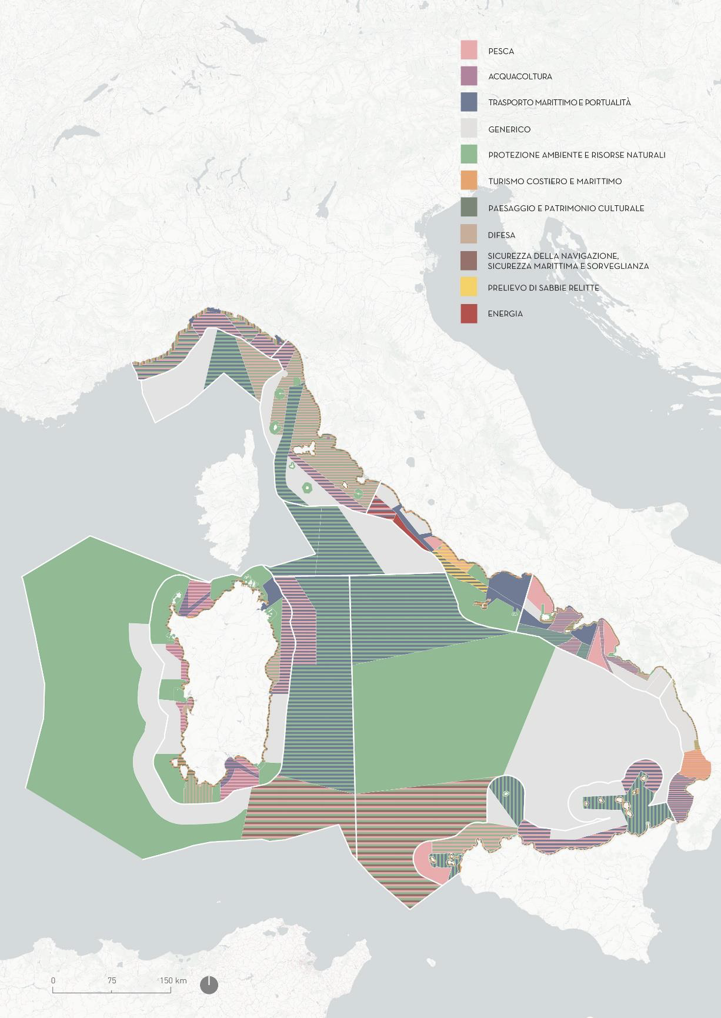
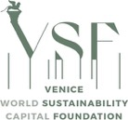



Thank you
WWW.IUAV.IT
francesco.musco@iuav.it
Università Iuav di Venezia

