Slide 1


The Marchica Lagoon of Nador (Morocco), towards a sustainable development.
November 17, 2025
Teatro Piccolo Arsenale, Venezia
Pr. Mimoun AALAOUL

Slide 2
2008
Present
Early 20th century
Development work carried out so far
Tasks to be completed & Recommandations
Time
The first urban center appears
Creation MarchicaMed
Marchica agency

Slide 3
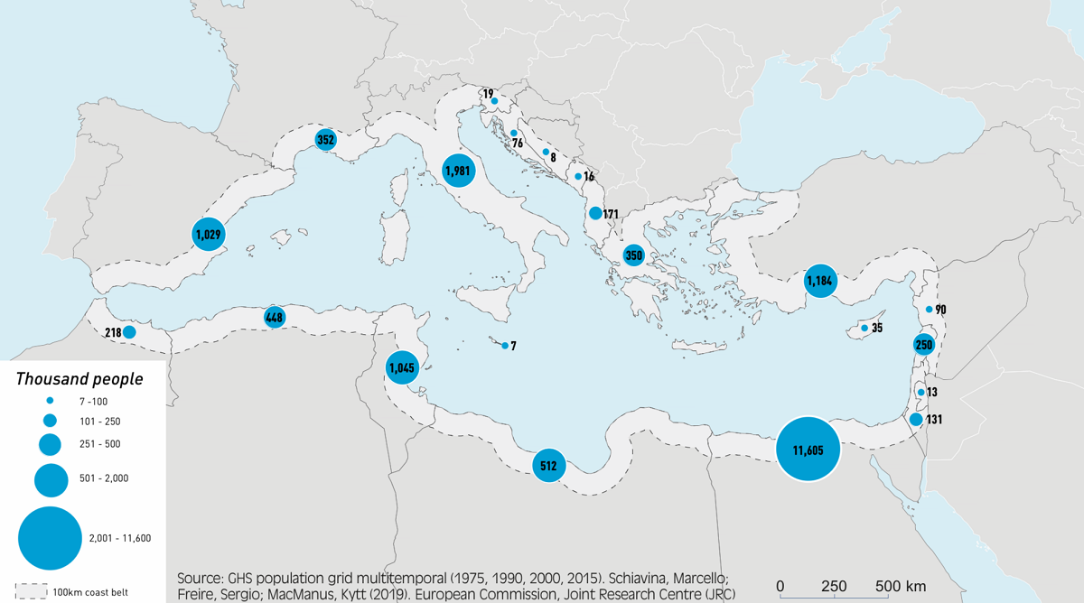
Introduction
More than half of the world's population lives within 100 km of the coast.
1/3 of Mediterranean population
Marine and coastal environments are essential ecosystems for biodiversity and human well-being
Faced with threats such as pollution and urbanization, (ICZM) has become imperative. Morocco has ratified the Mediterranean ICZM (the transition to Integrated Coastal Zone Management) Protocol, which requires the development of regional and national plans to reconcile economic and social dimensions with environmental protection.

Slide 4
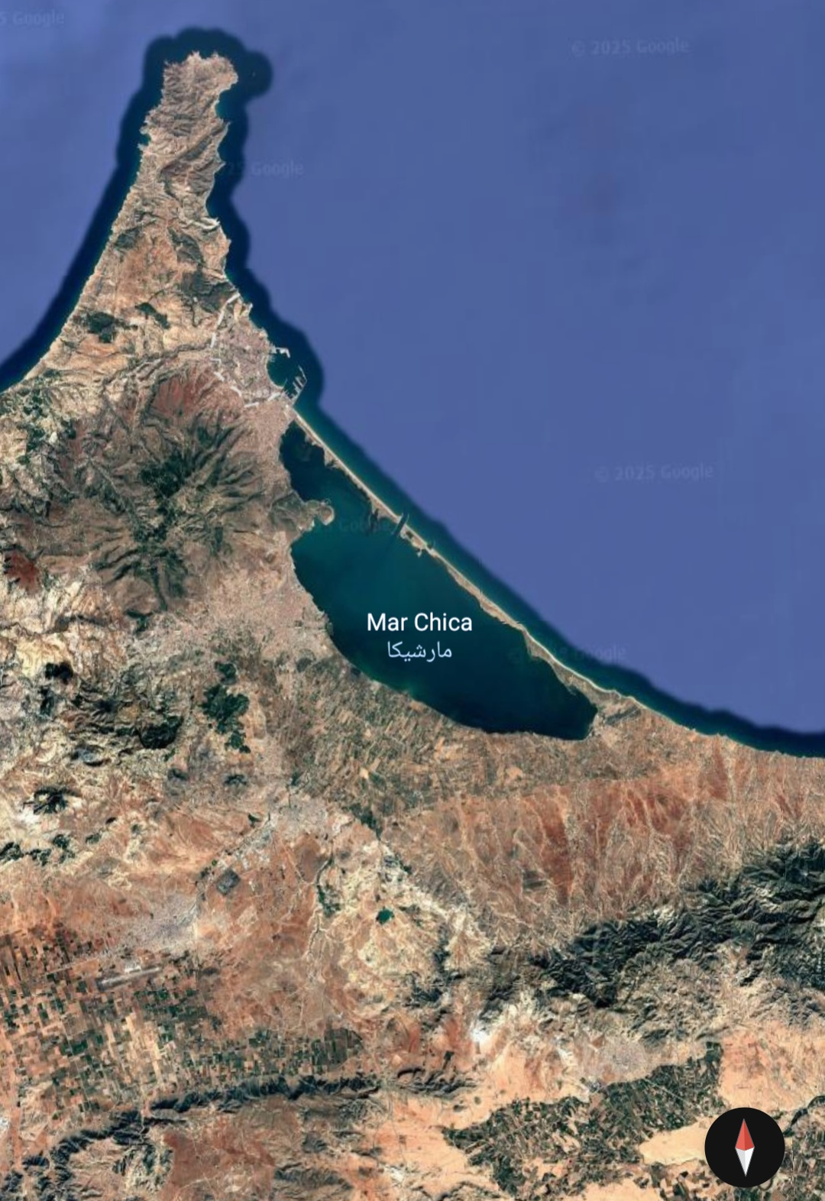
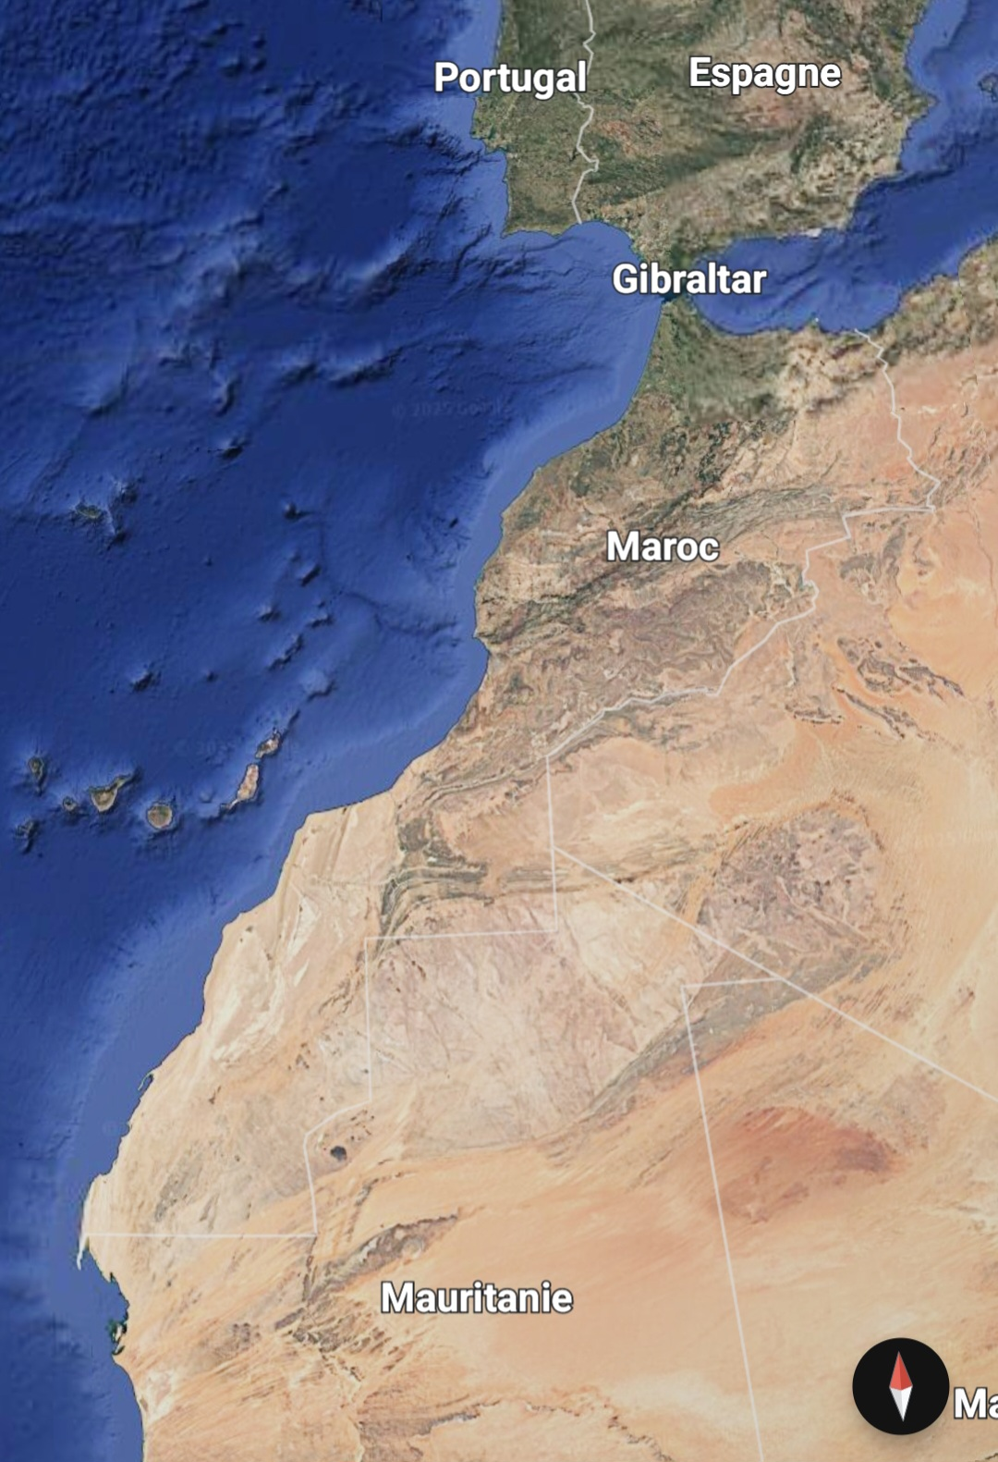
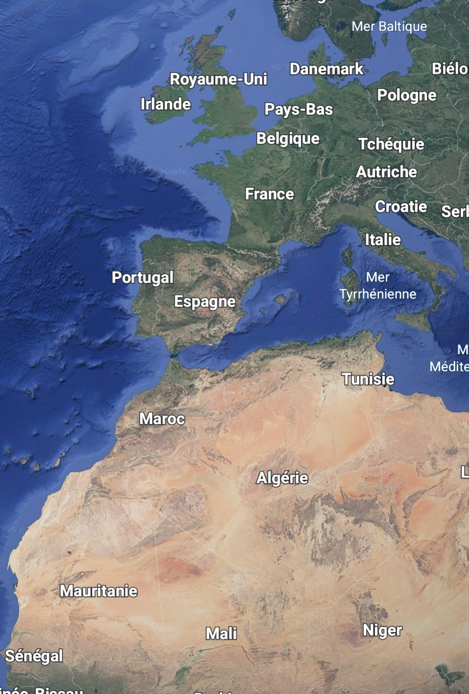
the geographical and geological context

Slide 5
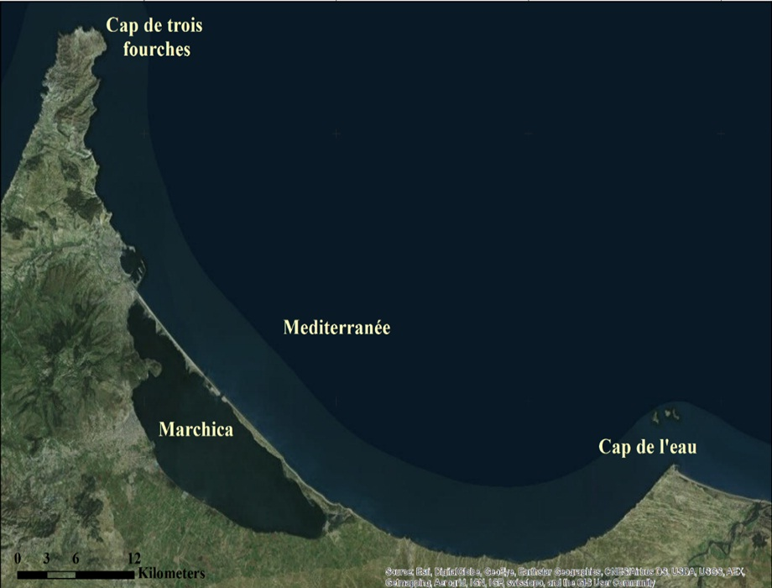
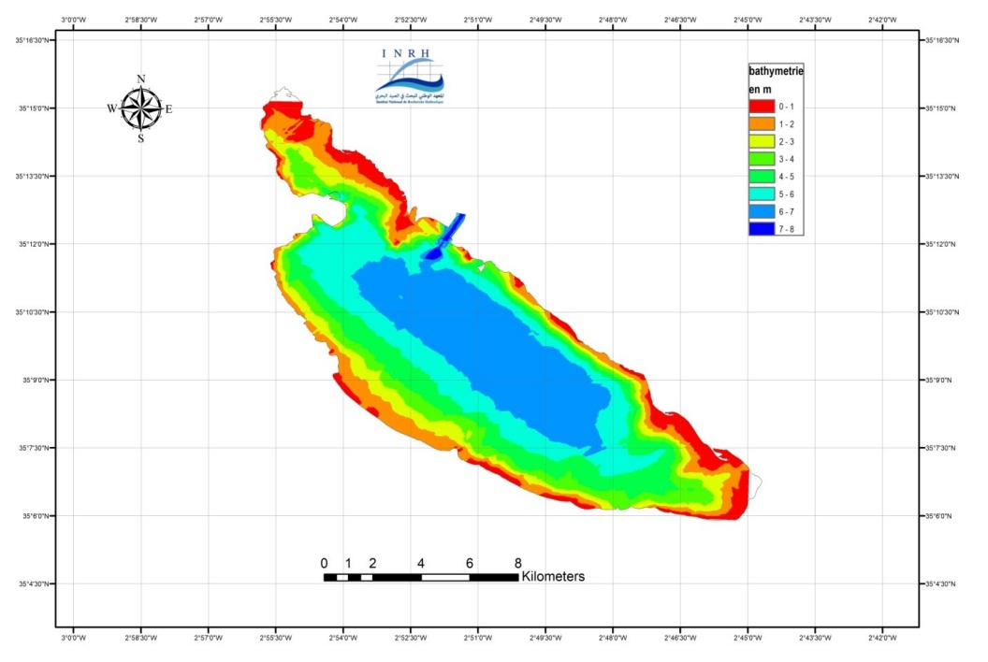
General data:
Located in northeastern Morocco, it is the second largest lagoon in the southern Mediterranean.
Site classified in RAMSAR sites since 2005
Classified as SIBE (Site of Biological and Ecological Interest)
Surrounded by 4 municipalities, about 260.000 inhabitants
Launch of 7 projects since 2008
It receives fine sediments: sand, silt, and clay
Surface : 115 Km² (Max length: 25km, Max width: 7,5km, Max depth 8m)

Slide 6
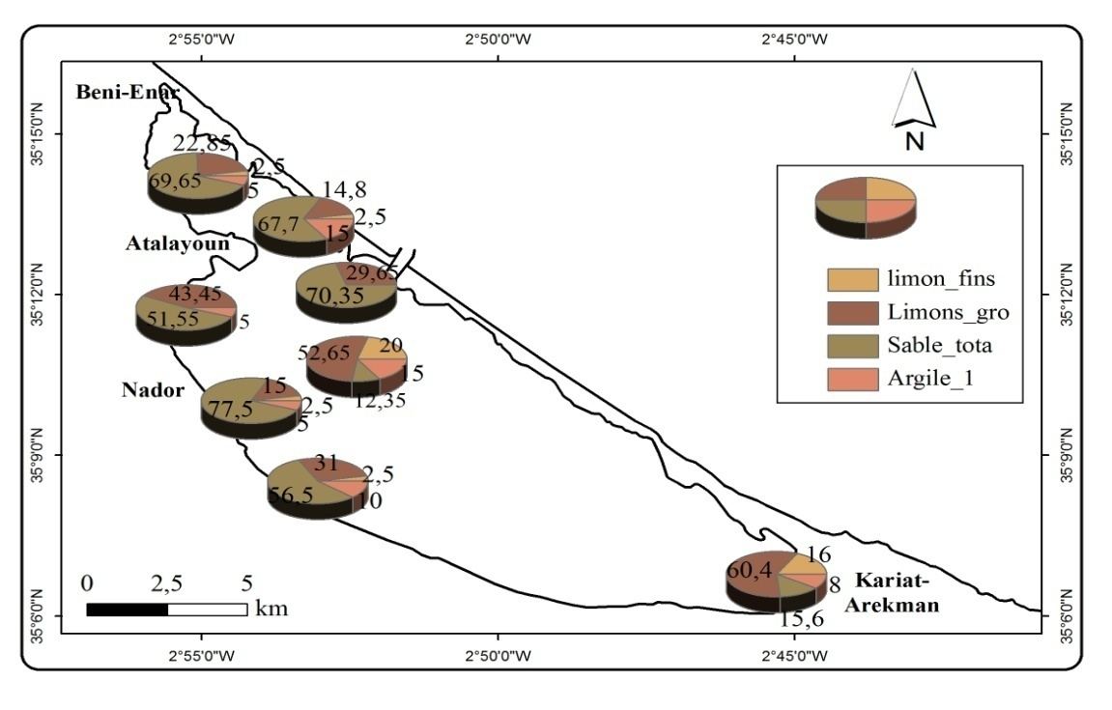
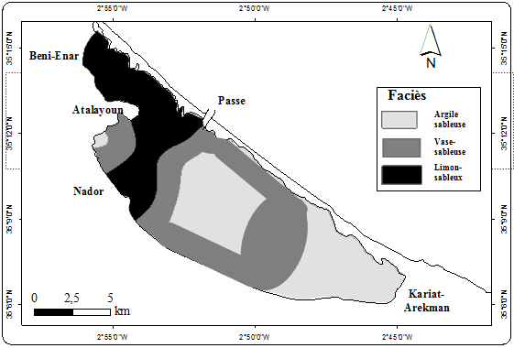
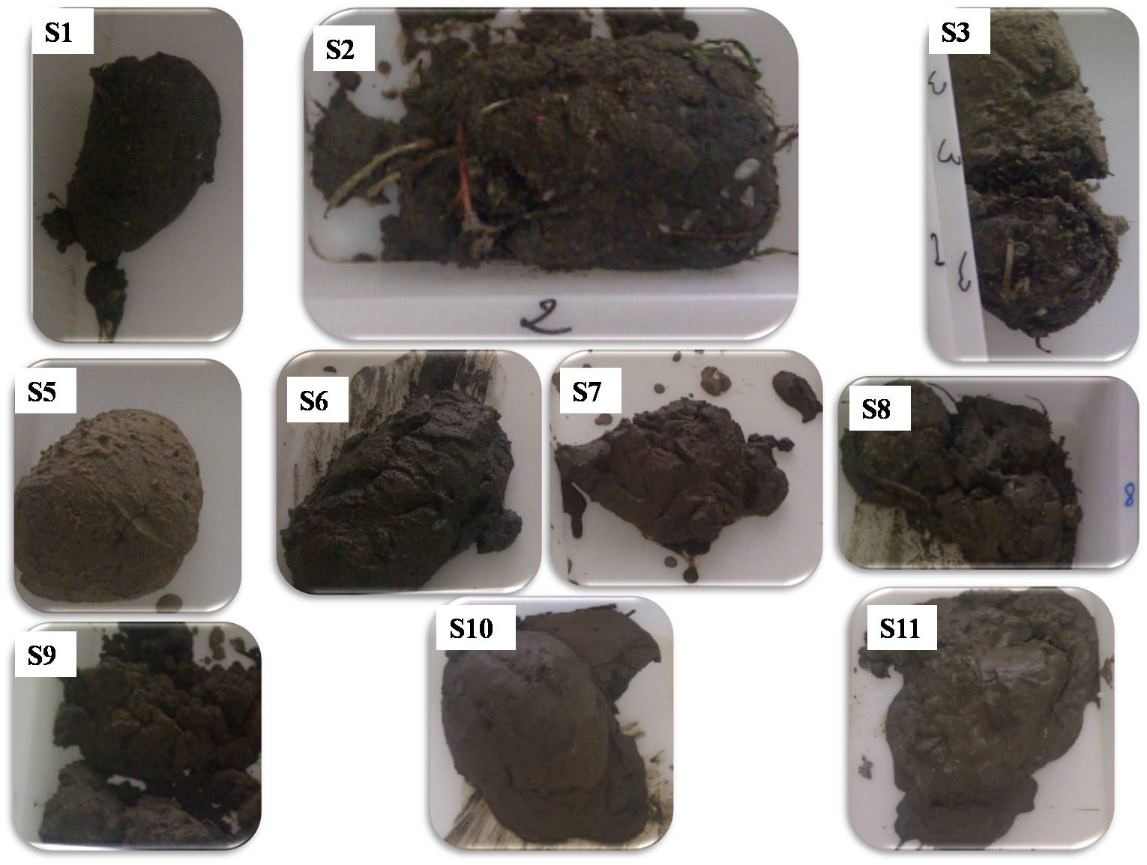
Particle size distribution
% | Argile | Limon fins | Limon grossier | Sable totals
Max | 15 | 20 | 60,4 | 77,7
Min | 0 | 0 | 14,8 | 12,35

Slide 7
the various constraints that interact on the lagoon

Slide 8
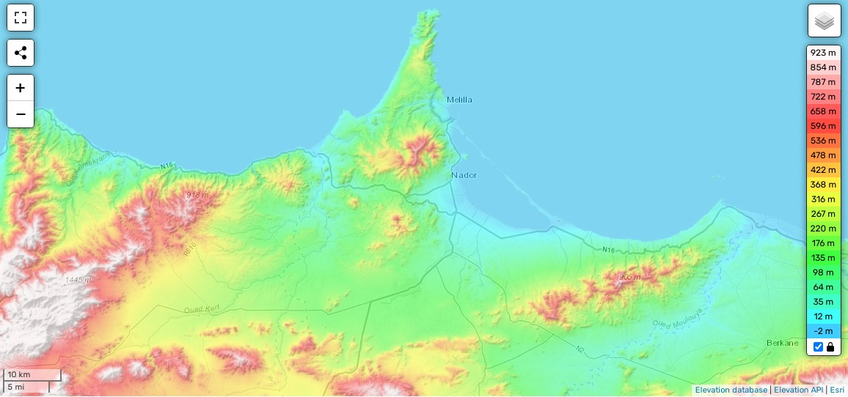
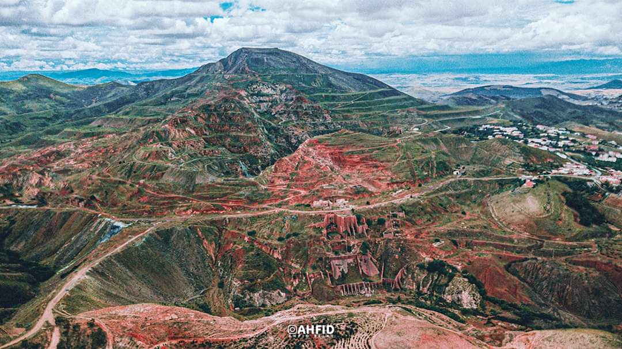
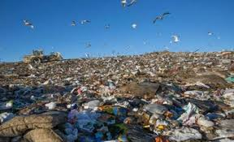
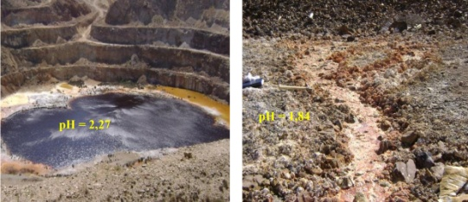
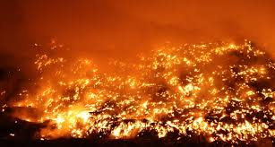
Iron mine
Public dump
Watershed limit

Slide 9
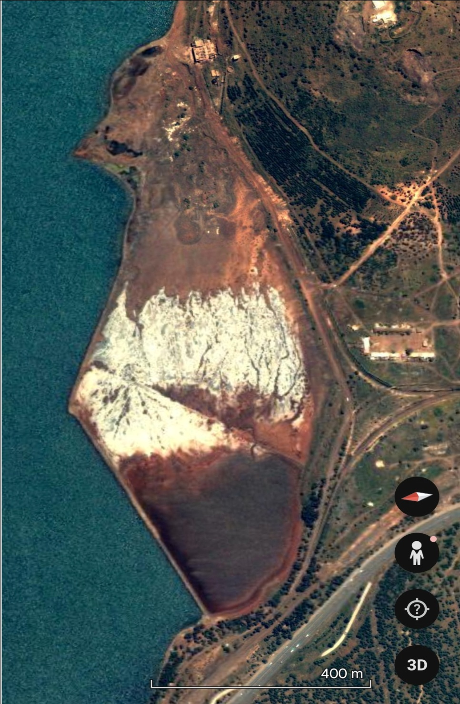
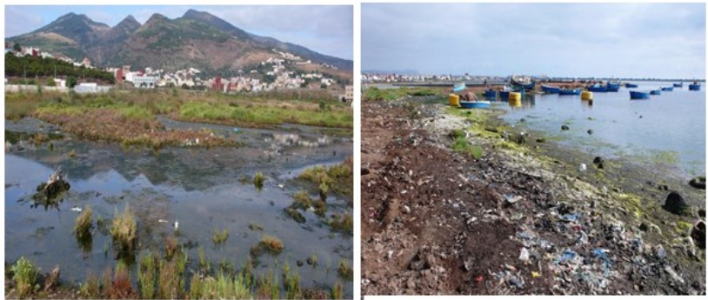
Ore washing plant
Settling basin

Slide 10
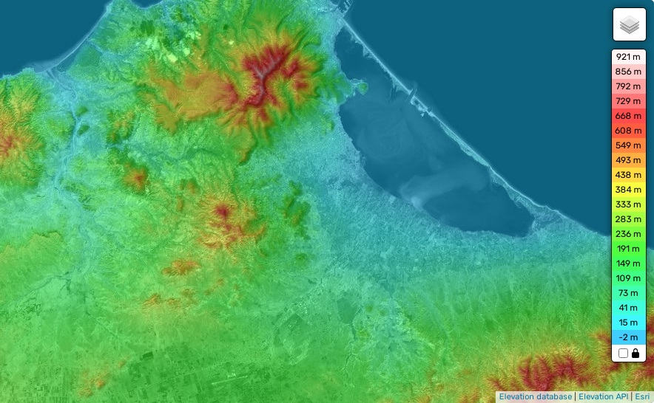
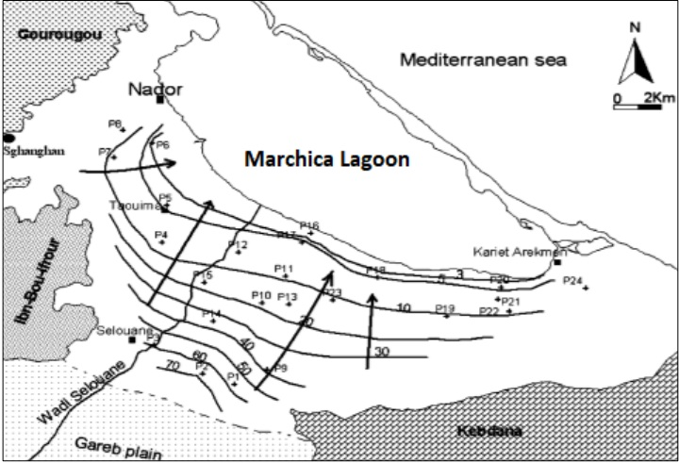
1
2
3
Groudwater shift
The hydrological regime : influenced by Mediterranean inputs, groundwater, and continental waters.

Slide 11
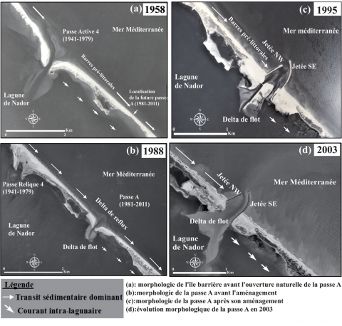

Slide 12
2008
Time
Creation : MarchicaMed
Marchica agency

Slide 13
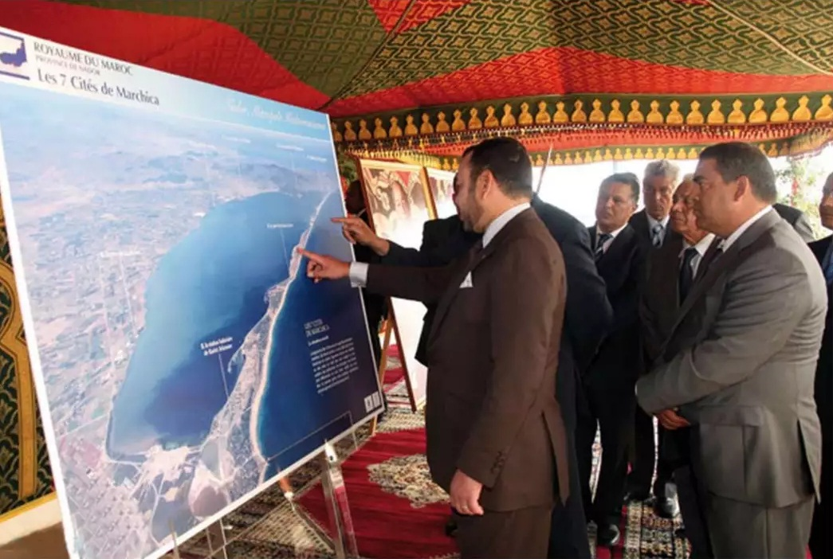
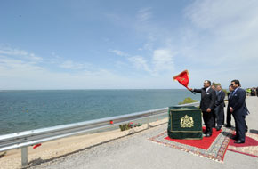
The launch of the major development project of Marchica by the king of Morocco on 2008

Slide 14
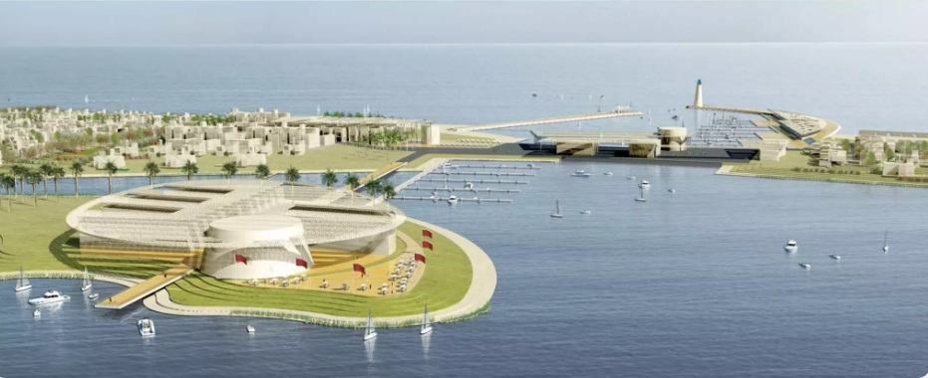
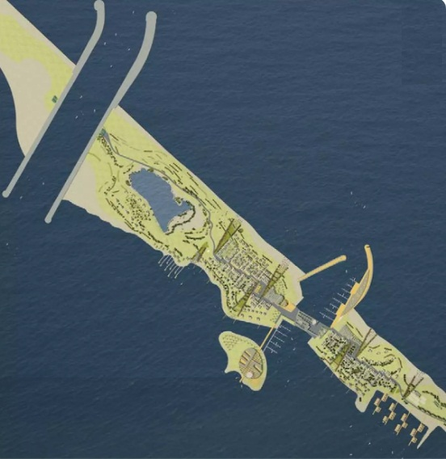
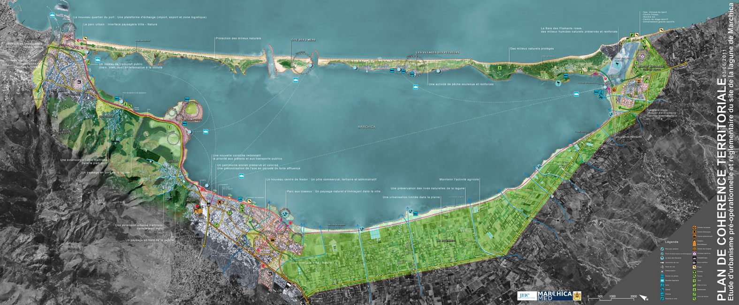
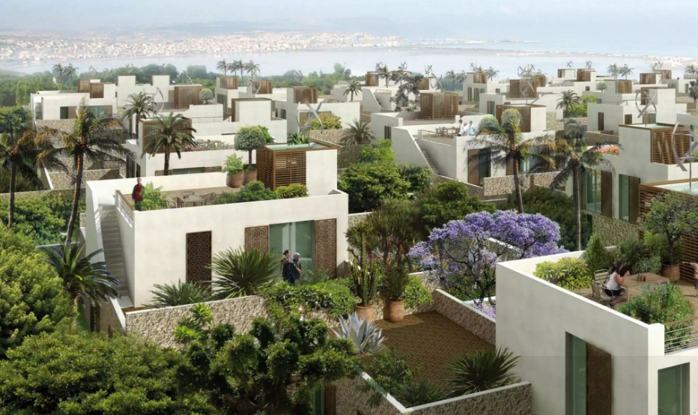
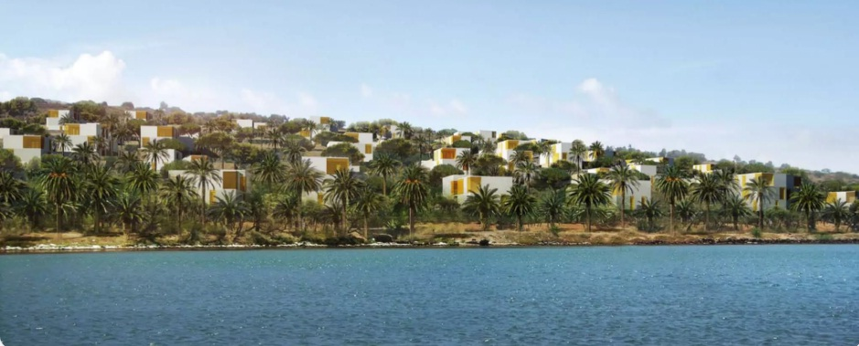
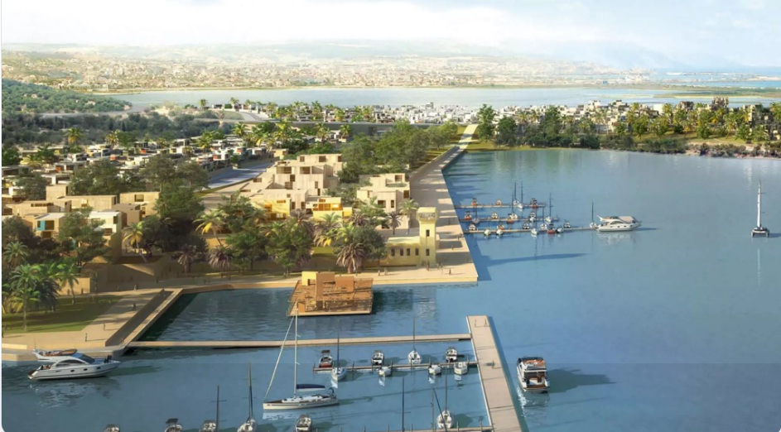

Slide 15
Development work carried out so far
Time
Present

Slide 16
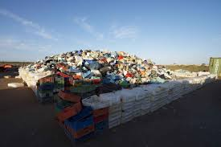
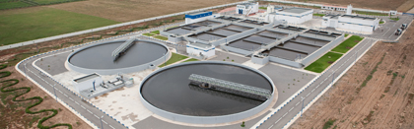
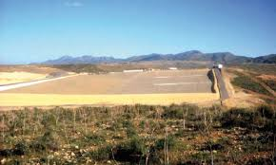
Upstream of the Marchica lagoon
Waste collection and sorting at specials place
New Sewage treatment plant of Big Nador
A new controlled Landfill…

Slide 17
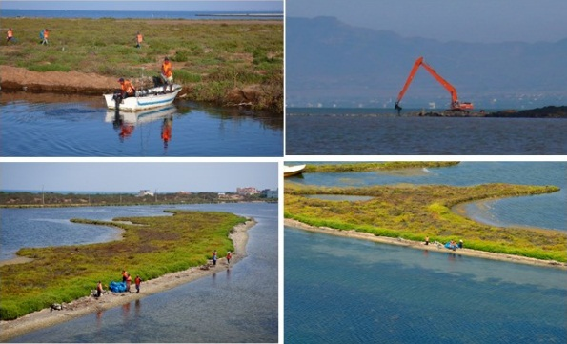
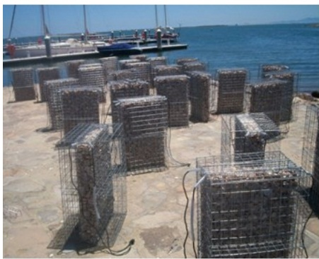
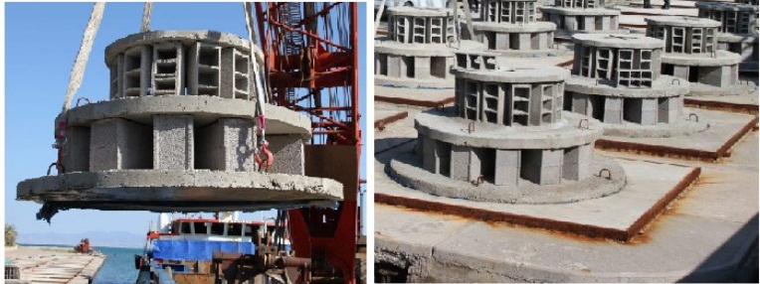
Downstream (in the lagoon and around it)
Pollution cleanup work of the Lagoon
Installation of Biohuts and artifitial reef

Slide 18
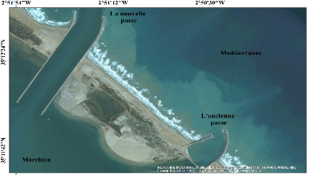
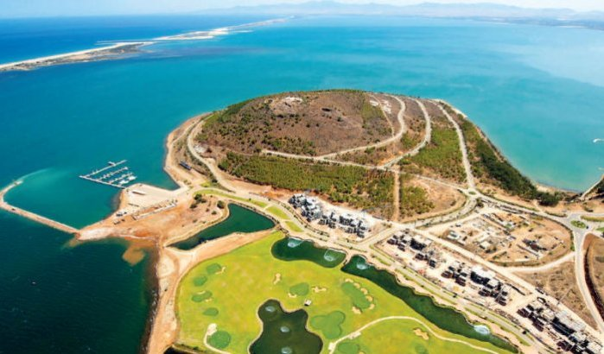
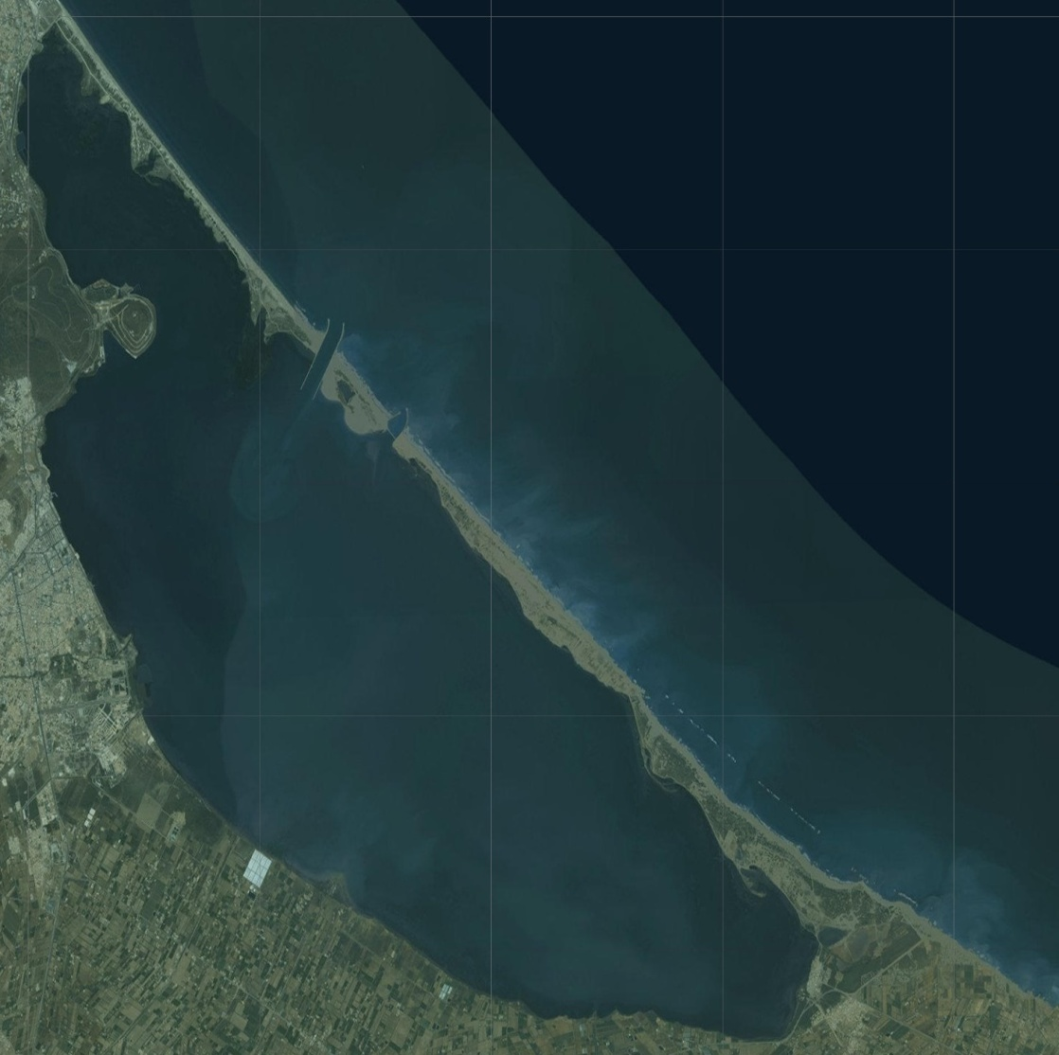
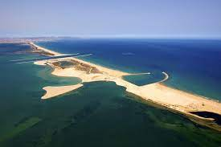
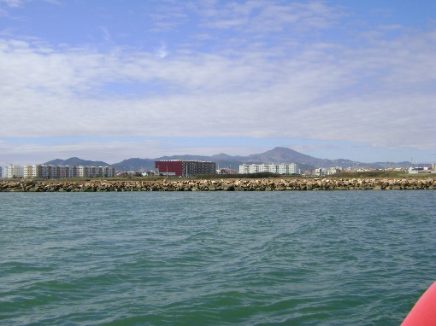
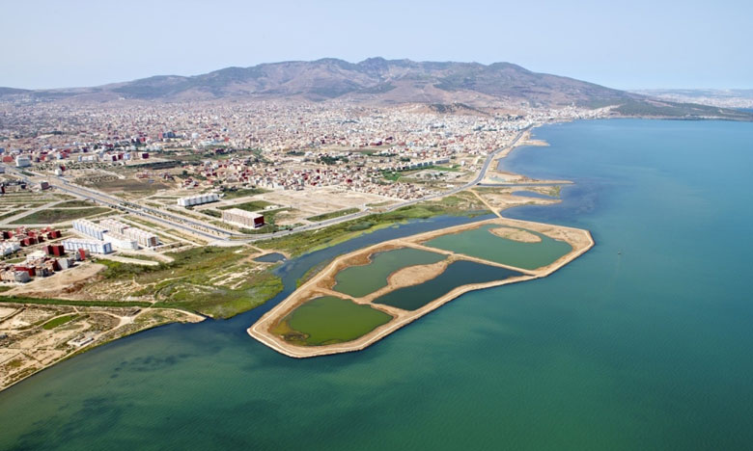
Nador lagoon
New pass
City of two seas
Atalayoun
Ornithological park
New Nador

Slide 19
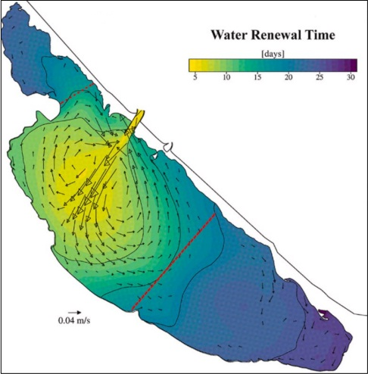

Slide 20
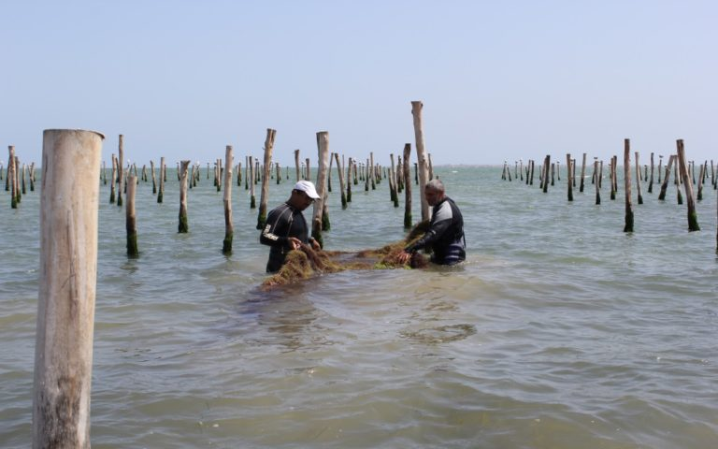
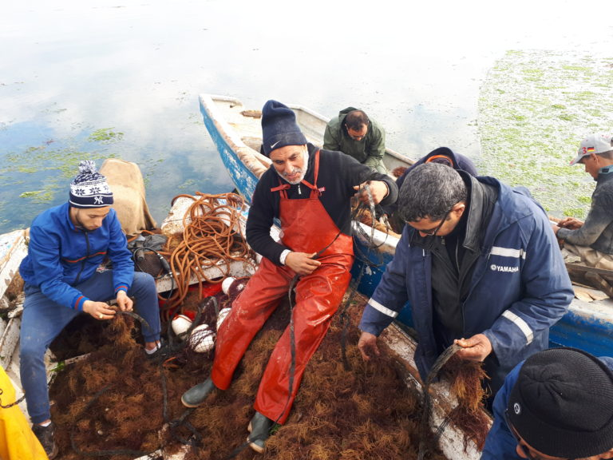

Slide 21
2008
Present
Tasks to be completed
&
Recommandations
Time
Despite all the efforts made, the environmental challenges remain significant and require continuous and cordinated work among the various stakeholders on site

Slide 22
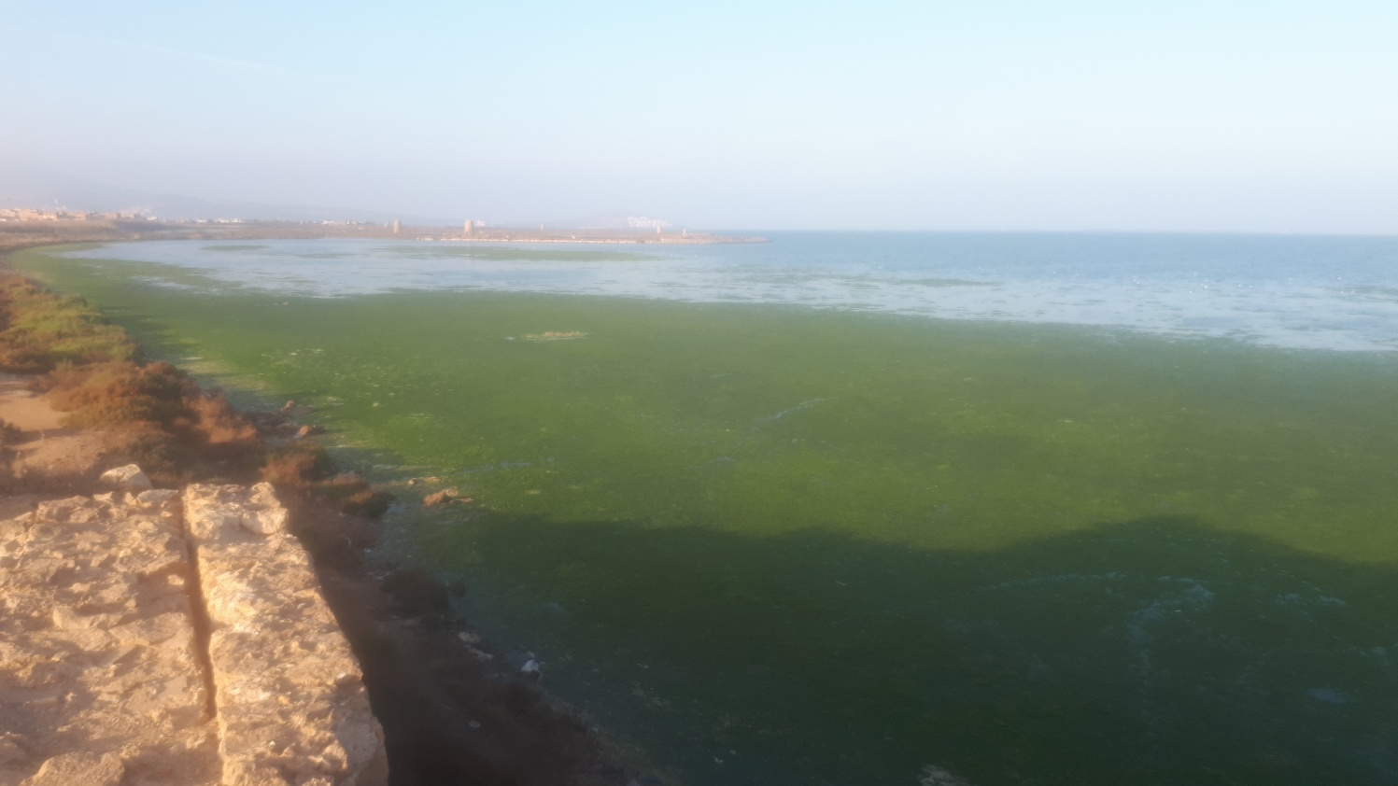
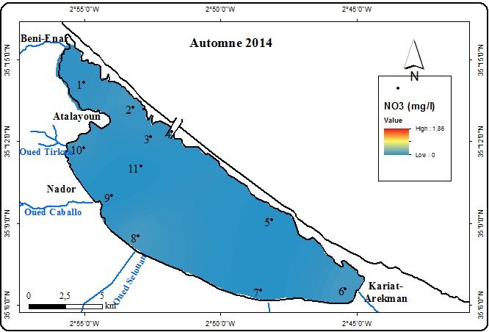
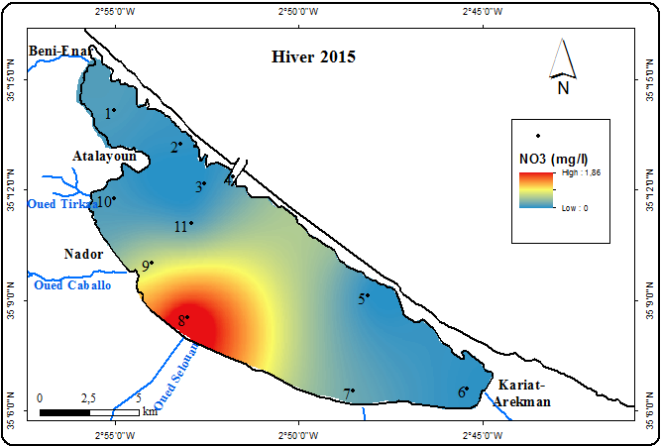
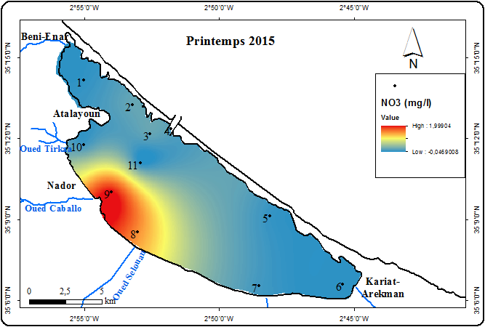

NO3
NO3 mg/l | Automne 2014 | Hiver 2015 | Printemps 2015 | Eté 2015
Max | 0,071 | 0,204 | 1,9 | 0,18
Min | 0 | 0,012 | 0 | 0
Moy. | 0,028 | 0,095 | 0,36 | 0,075
Water eutrophication

Slide 23
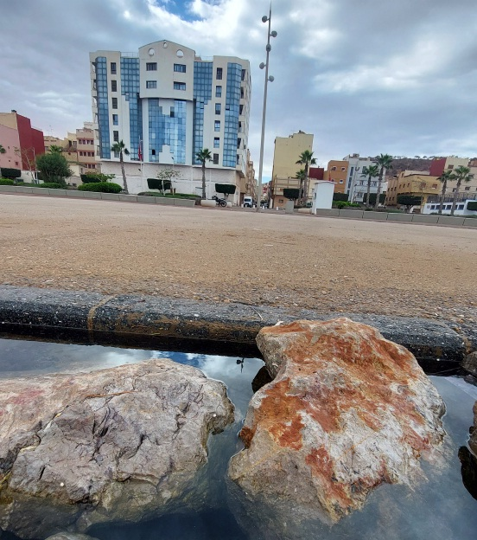
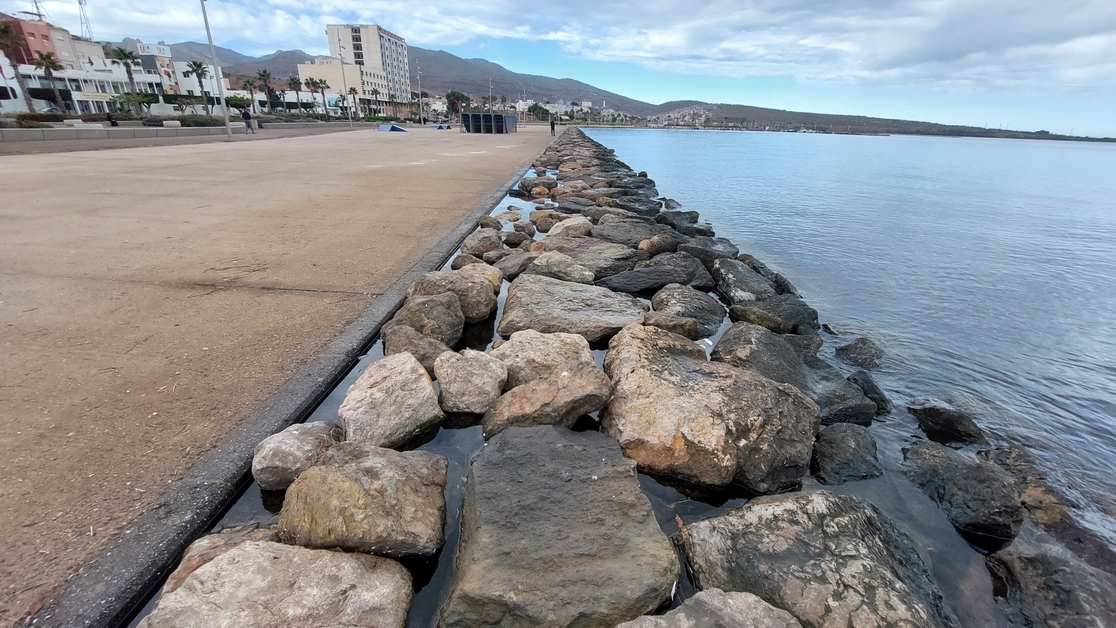
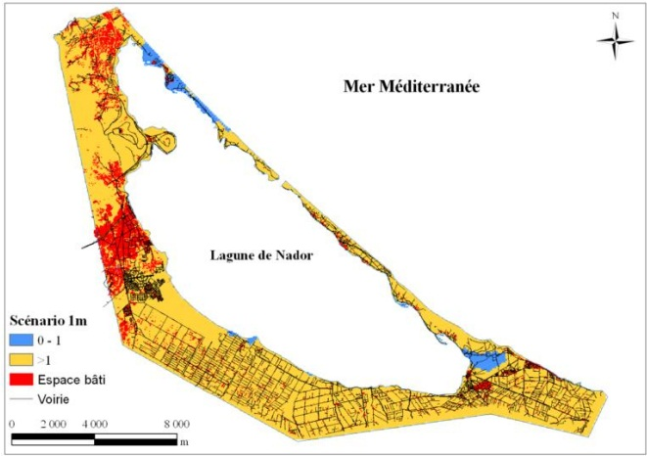
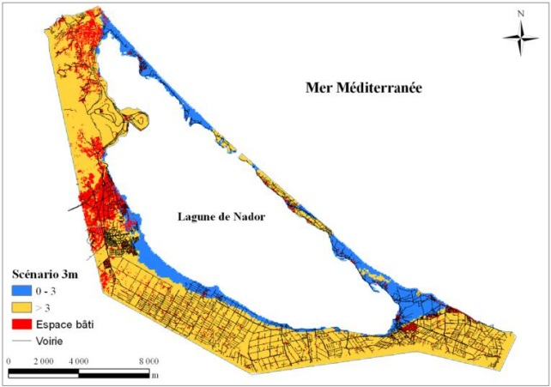

Environment issues: SEA LEVEL RISE

Slide 24



Slide 25

Marchica Lagoon
ARKMAN

Slide 26




Slide 27






Slide 28




Dissolved Oxygen
O2.D mg/l | Automne 2014 | Hiver 2015 | Printemps 2015 | Eté 2015
Max | 10,3 | 12.75 | 10,35 | 9,02
Min | 9 | 6.49 | 7.8 | 2,5
Moy. | 9.38 | 9.95 | 8.81 | 7,10

Slide 29





Slide 30


Invasive species
Sea hares
The blue crab: Callinectes sapidus

Slide 31


Invasive species
Posidonia oceanica, Native algae
Caulerpa prolifera, Invasive algae

Slide 32
Specific objectives
Implement a scientific and participatory strategy for the sustainable management of linking the Marchica lagoon to the Mediterranean Sea and other ecosystems
Identify and map different habitats and marine recruitment areas;
Model the ecological connectivity between lagoon and sea;
Integrate environmental and contamination data to assess nursery quality;
Identify priority areas for conservation and restoration;
Strengthening territorial governance through decision-making tools.
A civil society engagement!
Education & awareness (from the school to university…)

Slide 33


Slide 34

Thank you!

